Slide 1
NCSC Video Remote Interpreting Resource Center
Assessing Your
Readiness for VRI
MODULE 4

Slide 2
Introduction
NCSC Video Remote Interpreting Resource Center
In Modules 1–3, you reviewed the necessary VRI tools and learned some tips for success.
In this module, you’ll demonstrate your readiness for video remote interpreting in four real-world scenarios.
Notes:
In modules one through three, you reviewed the necessary VRI tools and learned some tips for success. In this module, you’ll demonstrate your readiness for video remote interpreting in four real-world scenarios.

Slide 3
Overview
NCSC Video Remote Interpreting Resource Center
Environment
Equipment
Communicate Your Needs
Ethics
Communication
Summary
Notes:
The module overview is shown here.

Slide 4
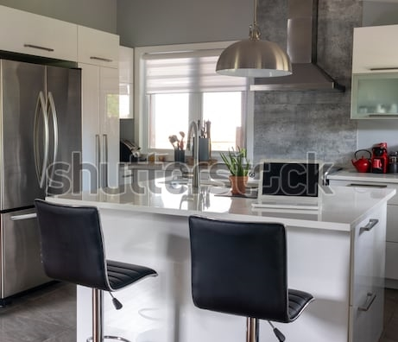
Environment 1
NCSC Video Remote Interpreting Resource Center
Environment
Is this space suitable for VRI?
Discuss its positive attributes.
Discuss its negative attributes.
Your interpreting environment is a key factor of success. A space that’s noisy or distracting can impede your performance.
In this activity, you’ll evaluate the suitability of three spaces for interpreting.
Notes:
This is an activity in which you’ll evaluate several spaces for their suitability as a VRI work setting.

Slide 5
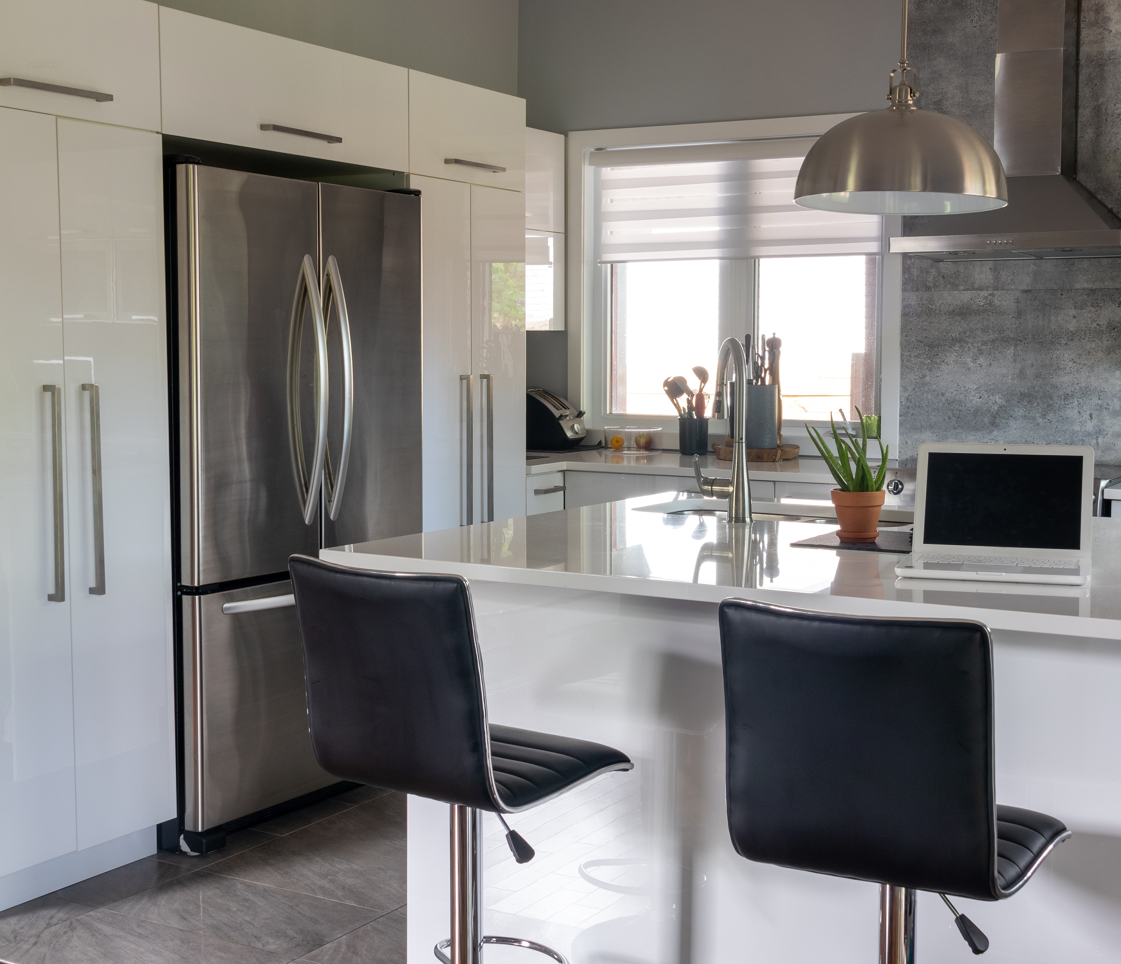
Environment 1
NCSC Video Remote Interpreting Resource Center
Is this space suitable for VRI?
Discuss its positive and negative attributes.
Notes:
Is this space suitable for VRI? What are the positives and negatives?

Slide 6
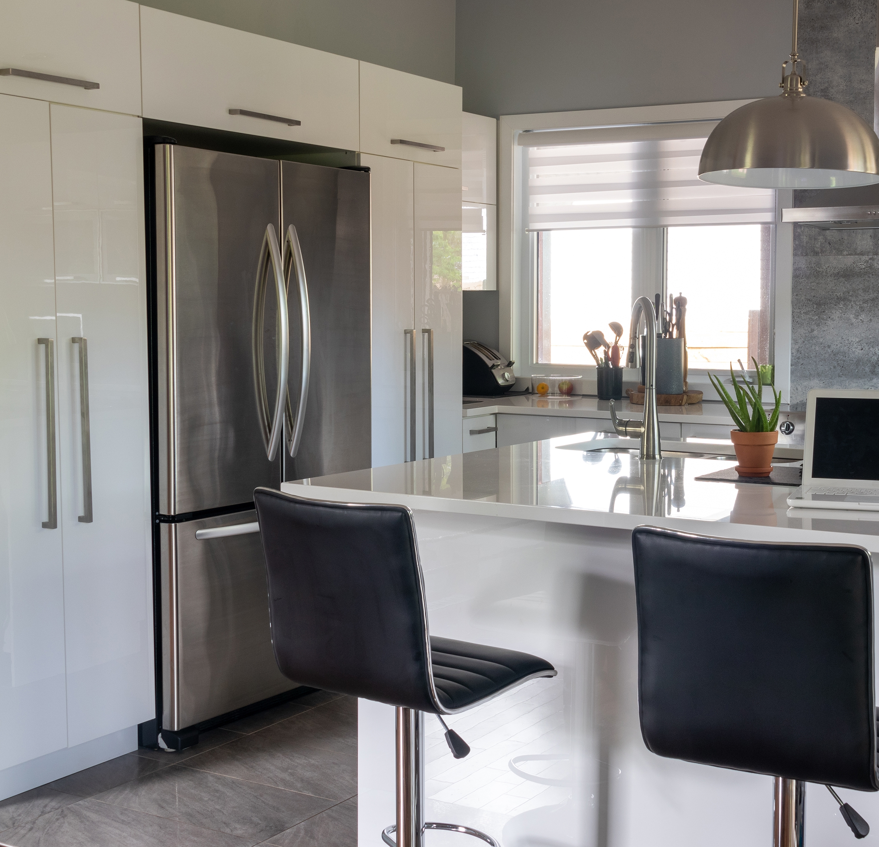
Environment 1
NCSC Video Remote Interpreting Resource Center
Experts say:
Positives
An in-home environment can be a good place to interpret, and the space appears to be well-lit.
Negatives
A kitchen is typically one of the busiest spaces in a home, and would not be an ideal area to set up a dedicated VRI station. In addition, the seating may not be comfortable for longer hearings.
Is this space suitable for VRI?

Slide 7
Environment 1
NCSC Video Remote Interpreting Resource Center
Experts say:
Positives
An in-home environment can be a good place to interpret, and the space appears to be well-lit.
Negatives
A kitchen is typically one of the busiest spaces in a home, and would not be an ideal area to set up a dedicated VRI station. In addition, the seating may not be comfortable for longer hearings.
Is this space suitable for VRI?
Recommendation:
A kitchen would not be the best place to perform video remote interpreting.

Slide 8
Environment 2
NCSC Video Remote Interpreting Resource Center
Is this space suitable for VRI?
Discuss its positive and negative attributes.
Notes:
What are the positives and negatives of this space for VRI?

Slide 9
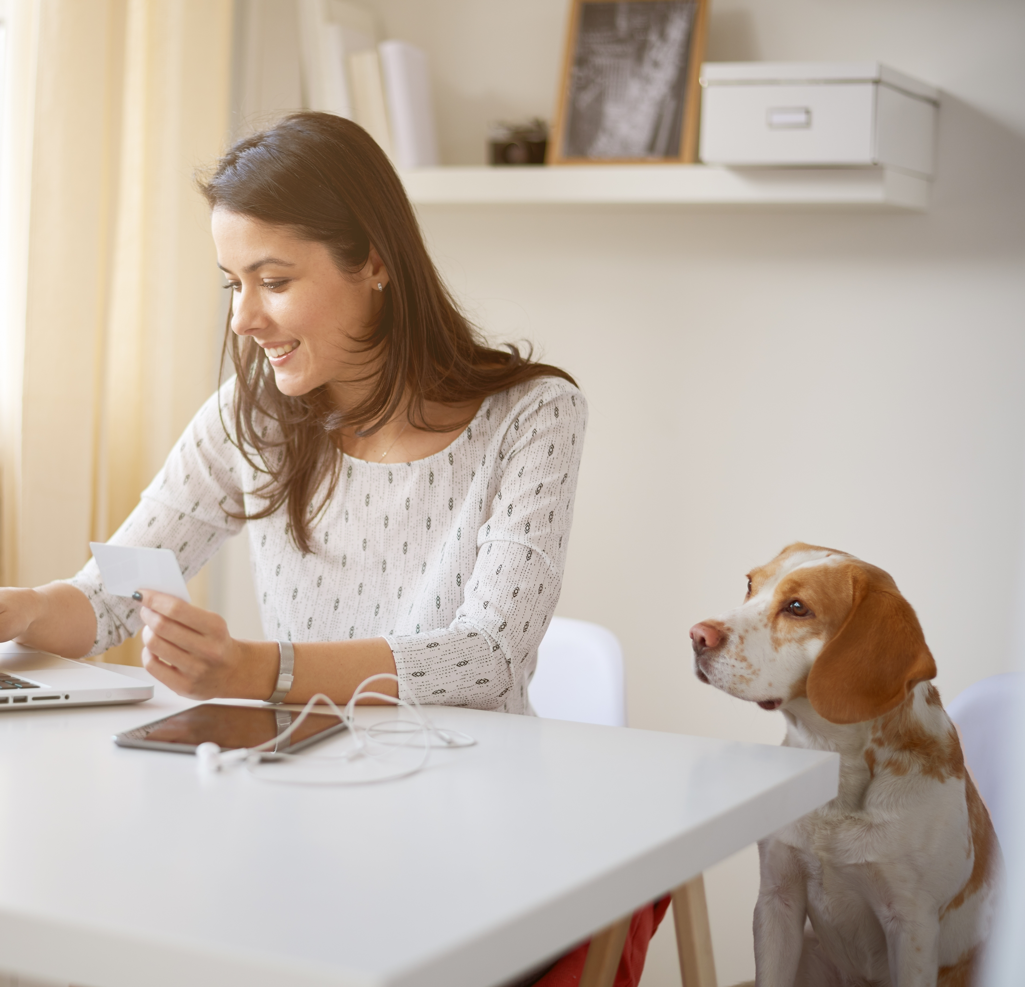
Environment 2
NCSC Video Remote Interpreting Resource Center
Experts say:
Positives
This appears to be a well-lit home office and may be sound-proof.
Negatives
Your VRI station should be set up in a sound-proof area without possible interruptions from family members or pets.
Is this space suitable for VRI?

Slide 10
Environment 2
NCSC Video Remote Interpreting Resource Center
Experts say:
Positives
This appears to be a well-lit home office and may be sound-proof.
Negatives
Your VRI station should be set up in a sound-proof area without possible interruptions from family members or pets.
Is this space suitable for VRI?
Recommendation:
This is not a suitable environment.

Slide 11
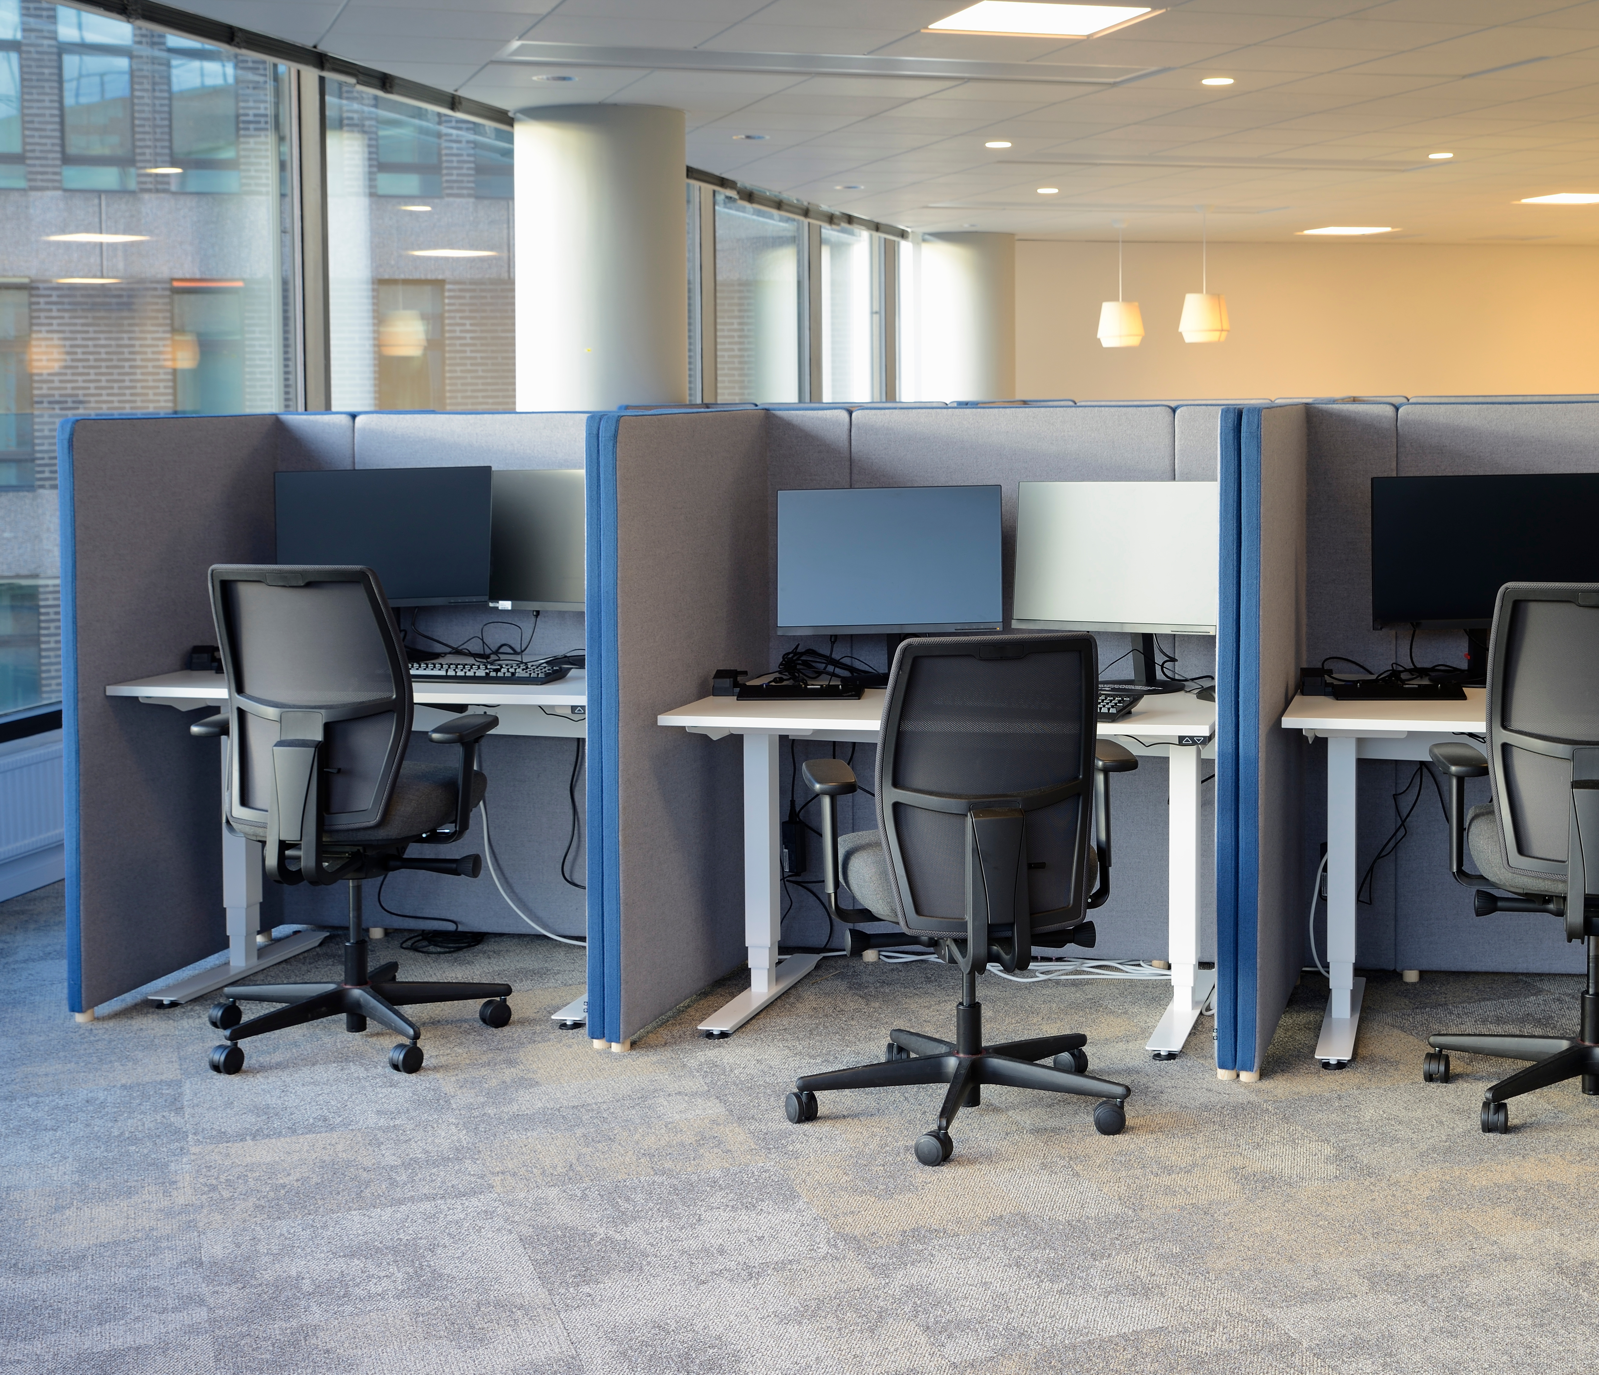
Environment 3
NCSC Video Remote Interpreting Resource Center
Is this space suitable for VRI?
Discuss its positive and negative attributes.
Notes:
What do you notice about this space?

