Slide 1
NCSC Video Remote Interpreting Resource Center
Assessing Your
Readiness for VRI
MODULE 4

Slide 2
Environment 3
NCSC Video Remote Interpreting Resource Center
Experts say:
Positives
This appears to be a professional work environment.
Negatives
An open working environment would not be sound-proof, creating a risk of distracting noises and confidentiality issues.
Is this space suitable for VRI?

Slide 3
Environment 3
NCSC Video Remote Interpreting Resource Center
Experts say:
Positives
This appears to be a professional work environment.
Negatives
An open working environment would not be sound-proof, creating a risk of distracting noises and confidentiality issues.
Is this space suitable for VRI?
Recommendation:
An open working environment is not appropriate for interpreting. First, the noise factor is not helpful to VRI and second, this environment does not provide confidentiality.

Slide 4
Remember
NCSC Video Remote Interpreting Resource Center
Nice work. Remember that the space you choose for delivering interpreting services should be:
Well-lit
Distraction-free
Sound-proof
Designated for interpreting
Confidential
Notes:
Nice work. Remember that the space you choose for delivering interpreting services should be well-lit, distraction-free, and in a sound-proof room designated for court interpreting.

Slide 5
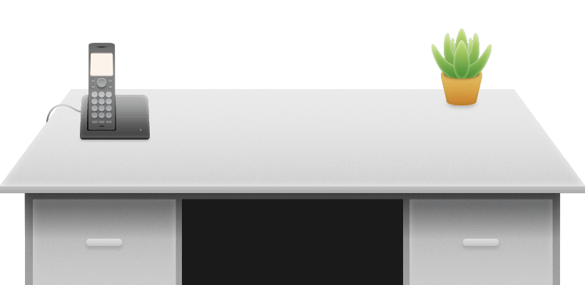
Equipment
NCSC Video Remote Interpreting Resource Center
Discuss which items apply:
Stacy is setting up her VRI station. She already has one item on her desk. What else does she need?
Computer
Computer with camera
Headset
Headset with microphone
Notebook
Speakers
Notes:
Take a look at what Stacy already has on her desk. What else does she need?

Slide 6
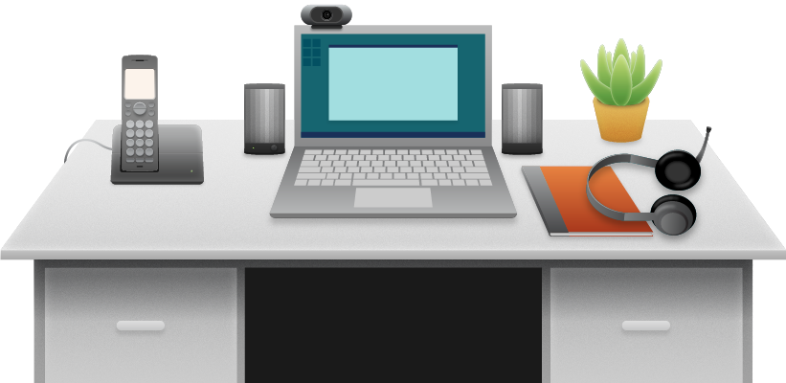
Equipment
NCSC Video Remote Interpreting Resource Center
Stacy will need:
A microphone and headset
A computer with high-speed internet and a camera
A notebook
It is highly recommended that you use your equipment only for VRI. You must maintain your equipment and keep it up to date.
Stacy is setting up her VRI station. She already has one item on her desk. What else does she need?
Speakers are optional.
Notes:
Stacy will need a microphone and headset, and a computer with high-speed internet and a camera. Speakers are optional.

Slide 7
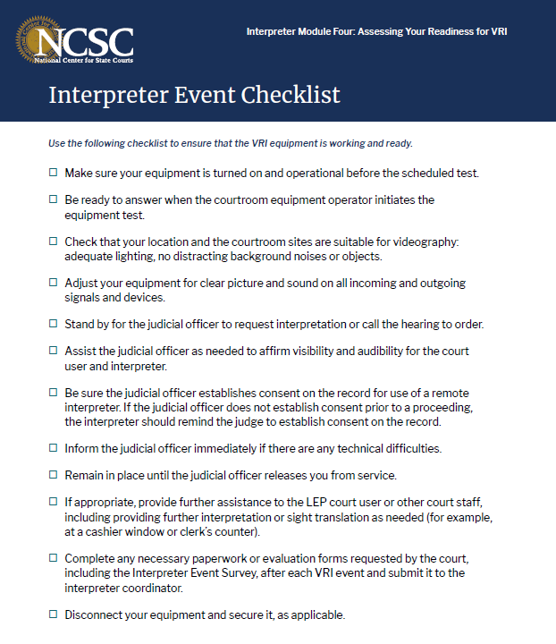
Equipment Readiness Checklist
NCSC Video Remote Interpreting Resource Center
A downloadable checklist is available to complement this course. Use it to ensure that the VRI equipment is working and ready.
Notes:
In the first two scenarios, you chose your VRI environment and acquired your equipment. Review the checklist to make sure that the VRI equipment is working and ready.
This is a thumbnail view of the downloadable checklist.
Downloads are here:
http://www.ncsc.org/~/media/Files/PDF/Services%20and%20Experts/Areas%20of%20expertise/Language%20Access/VRI/3%20Interpreter%20Support/NCSC-Interpreter-Tips-For-Hearing-112519.ashx
http://www.ncsc.org/~/media/Files/PDF/Services%20and%20Experts/Areas%20of%20expertise/Language%20Access/VRI/3%20Interpreter%20Support/NCSC-Interpreter-Event-Checklist-112519.ashx

Slide 8
Communicate Your Needs
NCSC Video Remote Interpreting Resource Center
In every hearing, it’s crucial that you communicate what you need to accurately interpret.
Notes:
Next, we’ll view ways to communicate without interrupting the proceedings.

Slide 9
Communicate Your Needs
NCSC Video Remote Interpreting Resource Center
Each hand gesture shown here has a meaning.
Notes:
Because it’s not always appropriate to verbally interrupt, you can use hand signals to convey messages to the court or to your VRI team. We’ve given you five hand gestures as examples, but you may decide on others with your team.

Slide 10
Communicate Your Needs
NCSC Video Remote Interpreting Resource Center
Each hand gesture shown here has a meaning.
Thumbs up:
Everything is good.

Slide 11
Communicate Your Needs
NCSC Video Remote Interpreting Resource Center
Each hand gesture shown here has a meaning.
Thumbs up:
Everything is good.
Up and down:
Slow down.

Slide 12
Communicate Your Needs
NCSC Video Remote Interpreting Resource Center
Each hand gesture shown here has a meaning.
Thumbs up:
Everything is good.
Up and down:
Slow down.
Time out:
The interpreter needs a break.

