Slide 1


Module Three:
www.eldersandcourts.org
Elder Abuse & Neglect
Crafting Court Responses
The National Center for State Courts developed this curriculum in collaboration with the Center of Excellence on Elder Abuse and Neglect at the University of California, Irvine School of Medicine with support from the Retirement Research Foundation of Chicago (grant number 2008-056).
www.eldersandcourts.org
Notes:
Note to Instructor: Some slides are animated and require you to CLICK to advance to the next discussion point. Animated slides are noted as such and include CLICK instructions.
The Notes included in this presentation are an abbreviated version of those found in the Instructor’s Manual. See the manual for more detailed information.
Recommended Presentation Time: 60 minutes
Handouts for Module 3:
NCSC Elder Abuse Benchcard
Adaptation of Benchcard by Florida’s 13th Judicial Circuit
Small Group Exercise—Case Scenarios and Questions

Slide 2
Module Three Goal
Goal
Judicial officers will learn how to craft court responses that effectively address elder abuse, neglect and exploitation in a variety of settings.

Slide 3

Module Three Objectives
At the conclusion of Module Three, judges should be knowledgeable about
    State elder abuse reporting requirements
    The importance of judicial leadership
    Strategies to build community-based responses
    Information needed to address elder abuse in a variety of court settings
Notes:
[Animated Slide]
CLICK to introduce each objective.

Slide 4
Crafting Appropriate Court Responses
Judicial Leadership
ABA Code of Judicial Conduct
State Code of Conduct
Community Resources
Task Forces
Multi-Agency Responses
Notes:
Two ingredients are critical to maximize the court’s response: Judicial Leadership and Community Resources
Judicial leadership is critical to ensuring that the court and the judicial process adequately address elder abuse. The value of judicial leadership in multi-agency coordination efforts has been demonstrated in several arenas, including child abuse and neglect, domestic violence and victims’ rights.
ABA Code of Judicial Conduct (2007) and state codes allow and encourage judges to engage in activities and initiatives to improve the administration of justice and advocate for the improvement of the justice system. For example:
Canon 1, Rule 1.2 Promoting Confidence in the Judiciary: A judge should initiate and participate in community outreach activities [to promote] public understanding of and confidence in the administration of justice. (Comment 6)
Canon 3, Rule 3.1 Extrajudicial Activities in General: …judges are encouraged to participate in appropriate extrajudicial activities. (Comment 1)
Canon 3, Rule 3.7 Participation in Educational, Religious, Charitable, Fraternal, or Civic Organizations and Activities: (A) …a judge may participate in activities sponsored by [entities] concerned with …the administration of justice…
Resources specific to the needs of elders can be found in every community. Many communities have elder task forces . It can be beneficial for the court to participate in such task forces so that community resources can be identified and mobilized in elder abuse cases. In addition, some communities feature multi-agency response teams that work to address specific cases, such as those involving financial exploitation.
In the absence of coordinated community responses, the court has an opportunity to demonstrate its leadership by bringing agencies and organizations to the table.

Slide 5
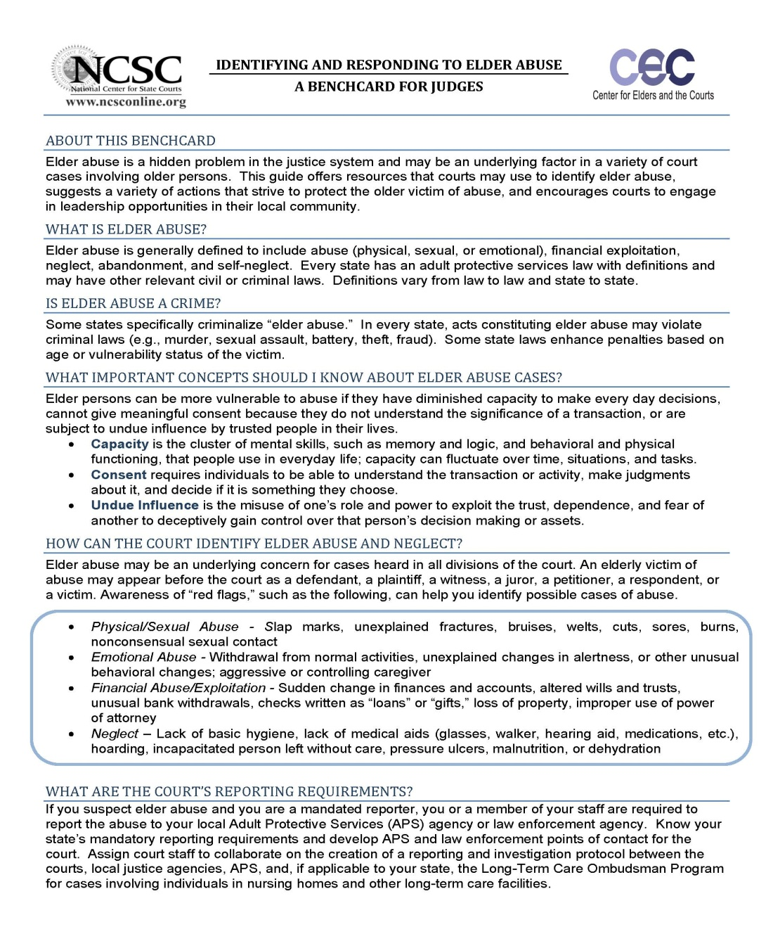
Benchcard for Judges
What is elder abuse?
Is elder abuse a crime?
What important concepts should I know
  about elder abuse cases?
How can the court identify elder abuse and neglect?
What are the court’s reporting requirements?
What tools are available to help the court respond
to elder abuse?
Where can I find more information?
Notes:
[Hand out copies of the NCSC Elder Abuse Benchcard]
The benchcard is a concise guide to elder abuse issues for judges. It is not specific to criminal acts of elder abuse and neglect. It was designed to be a quick reference that will help judges identify elder abuse in cases coming before the court and consider effective responses.
The benchcard addresses many of the issues discussed in modules 1 & 2 and coming up in this module.
Note to Instructor: Do not go over details of benchcard at this time. Instead, note that it includes the following topics, many of which were already discussed in earlier modules:
Definitions
Important Concepts
Types of abuse and red flags
Reporting requirements
Case management tools
Remediation tools

Slide 6
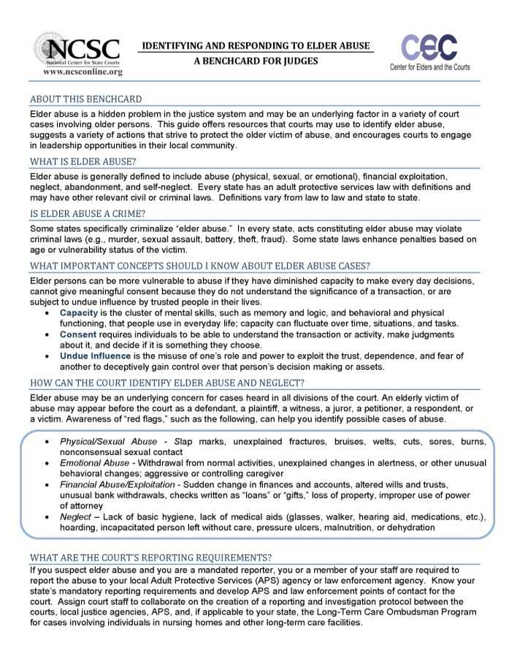
Homework Exercise
Adapting the benchcard for
your jurisdiction
Notes:
[Hand out copies of Florida’s 13th Judicial Circuit Elder Abuse Benchcard]
The benchcard can be modified to suit the needs of your individual court or jurisdiction. We have given you a modified benchcard, created by Florida’s 13th Judicial Circuit, as an example.
When you complete this course, we ask that you consider developing a benchcard for your local jurisdiction. The benchcard provides a framework for starting the conversation with current and potential community partners. This conversation can be a catalyst for identifying needs and resources, working together to fill gaps, and improving coordination across the community to achieve better outcomes for elders in the courts.
Note to Instructor: Tell participants that both benchcards are available at NCSC’s Center for Elders and the Courts: www.eldersandcourts.org

Slide 7
Interactive Exercise
Shawn Marshall, 20, is arrested for possession of heroin in the apartment complex where he lives with his 72 year old grandmother, Mrs. Marshall. His case is assigned to you. Shawn has no prior offenses and pleads guilty.
The Pretrial Services investigation includes an interview with Mrs. Marshall. She tells staff she has tried to keep Shawn out of trouble over the past few years. He used to borrow money occasionally, but lately he has been pushing her to write checks to him almost every week. He brings strangers into the apartment at all hours and she has become fearful of him and his friends.
Shawn Marshall is scheduled to appear before you for sentencing. You read the pretrial services report which describes Mrs. Marshall’s concerns and fears about Shawn’s behavior.
Notes:
[Interactive Exercise]
[Note to Instructor: This slide is used in conjunction with the next slide.]
Read the scenario aloud.
Ask participants to consider the scenario in light of what they have learned in Modules 1 & 2 and to apply issues that were addressed in the DVD viewed at the conclusion of Module 2.
CLICK to the next slide, which brings up the specific questions/issues to consider.

Slide 8
What is going on?
What are the red flags?
What issues are raised?
What information do I need?
What should I do now?
Notes:
[Interactive Exercise—continued]
1. Ask participants to identify some of the “red flags.”
Possible responses:
Escalating demands for money
Grandmother fearful
Shawn depends on Mrs. Marshall for housing
Mrs. Marshall may be subject to eviction if her rent is federally subsidized
Shawn is using and may be selling drugs
2. Ask participants about the issues that may be raised that the court should/could address.
Possible responses:
Mrs. Marshall probably has ignored/covered up Shawn’s behavior thinking she’s protecting him
If Shawn is sentenced to probation, it will restrict his employment and housing options
3. Ask participants to identify information they would need to decide course of action.
Possible responses:
What is Mrs. Marshall’s medical condition? Does she have any cognitive disabilities or functional limitations?
Substance abuse assessment information on Shawn
Risk assessment for Shawn
4. Ask participants what they should do now.
Possible responses:
Refer Mrs. Marshall to legal services or pro bono attorney (protection order)
Refer case to Adult Protective Services (APS) for investigation
Appoint a guardian ad litem (GAL) for Mrs. Marshall
Issue a no-contact order
Allow only supervised contact between Mrs. Marshall and Shawn
Report abuse? To whom

Slide 9
Reporting Requirements
Mandated reporters who suspect elder abuse are required to report the abuse to the local APS or law enforcement agency.
Know your state’s mandatory reporting requirements
Develop APS and law enforcement points of contact for the court
Assign court staff to collaborate on the creation of a reporting and investigation protocol between the courts, local justice agencies & APS
Notes:
[Note to Instructor: Refer to NCSC Elder Abuse Benchcard.]
The court may need to report possible elder abuse. Judges and court staff should know the state law on reporting elder abuse. Most state laws require reports to the adult protective services agency or law enforcement.

Slide 10
Reporting Requirements
Insert your state reporting requirements here

Slide 11
Remediation Tools
Tailored restraining or “no contact” orders
Review hearings
Appointment of guardian ad litem
Notes:
[Note to Instructor: Refer to NCSC Elder Abuse Benchcard.]
Possible remediation tools might be tailored restraining, protective, or “no contact” orders, review hearings, and the appointment of a guardian ad litem.
Tailored restraining or “no contact” orders
A “no contact” order might not be appropriate if the victim is dependent on the other person for basic daily needs. Consider consequences for victim when deliberating over nature of order.
If the victim wishes to maintain a relationship with the offender, then consider supervised contact.
Recognize power imbalances that may affect victim’s ability to express true desires.
Order return of property, restitution, garnish wages or attach assets.
Review hearings
Review hearings should be set more frequently in cases that require close monitoring for compliance.
Cases involving reports of complaints about an elder’s welfare should be monitored more frequently.
Appointment of guardian ad litem
A guardian ad litem can monitor the provision of services and the elder’s welfare in her placement or treatment.

Slide 12
Remediation Tools
Encourage the use of victim/witness advocates
Provide opportunity for impact statement
Be creative in sentencing & use of alternative sanctions
Notes:
[Note to Instructor: Refer to NCSC Elder Abuse Benchcard.]
More examples of remediation tools to consider include encouraging the use of advocates, victim impact statements, and creative sentencing.
Advocacy
Judges should encourage the use of advocates, who may help the victim to access resources and create a safety plan
Victim Impact Statements
Provide opportunity for victim to speak about their experiences and to present a victim impact statement
Creative Sentencing
Be creative in sentencing and use of alternative sanctions (e.g., order return of property, restitution, garnish wages or attach assets)

Slide 13
Case Management Tools
Consolidate cases
Ensure accessibility
Expedite cases
Notes:
[Note to Instructor: Refer to NCSC Elder Abuse Benchcard.]
There are a number of case management tools that can be used to improve the experience of elders in the courtroom. These include changes that can improve accessibility, and setting up procedures that will expedite and consolidate cases.
Ensure accessibility
Ensure the courtroom is accessible and accommodates physical and/or cognitive impairments.
Hold court proceedings outside of the courthouse when necessary
Provide safe waiting areas for older victims and their families
Equip the courtroom to assist older persons with impairments
Hearing amplification, Non-glare lighting, Magnifying glass, Oxygen cylinder
Expedite cases
Expedite cases in which elder abuse is an underlying factor, including avoiding unnecessary continuances and delays.
Consolidate cases
If possible, consolidate ancillary cases involving the same family or victim to create a consistent, efficient, and therapeutic outcome; also to reduce burdens on elder victim when his or her presence is required or desired for multiple matters pending before the court .

Slide 14
Case Management Tools
Create elder protection court or docket
Memorialize testimony
Calendar cases
Notes:
[Note to Instructor: Refer to NCSC Elder Abuse Benchcard.]
Additional case management tools include calendaring cases, memorializing testimony and creating an elder court or docket.
Calendaring cases
Understand gradations of diminished capacity and calendar cases to accommodate medical needs and fluctuations in capacity and mental alertness.
Older persons may require more time to dress and make themselves ready for court, so schedule hearings later in the morning.
Avoid late afternoon hearings, when older persons with diminished capacity may experience “sundowning.”
Memorialize testimony
While preserving the defendant’s right of confrontation, consider procedures that assure the elder victim’s testimony is memorialized, such as videotaped examinations and conditional exams.
Create elder court or docket
An elder court or docket can provide more time to focus on elder cases. These courts/dockets are set at a particular time and cases are heard by a specially trained judge. Elder courts often work closely with local community groups that address the needs of the elderly.

Slide 15
Small Group Exercise
Each group considers one of the following case scenarios:
Family Violence
Neglect
Financial
Exploitation
Guardianship
Notes:
[Small Group Exercise – with Handouts]
[Note to Instructor: You may find it convenient to print each scenario on a different color of paper. This makes it easier for you to hand out the appropriate form to each member of the group and ensures that each person in the group is working from the same scenario.]
Recommended Time for Group Exercise:
10 minutes to work through scenarios and questions
10 to 15 minutes to report back to the larger group
Divide participants into groups of 3 to 5 persons. Because there are 4 scenarios, having 4 groups is most convenient.
Assign each group one of the 4 scenarios. Distribute handouts with scenarios and instructions for the group exercise.
Ask that each group designate someone who can report back to the larger audience.
Give participants 10 minutes to work through scenarios and questions. Click to the next slide while group members are working.
Call upon the groups to report in the order on this slide.

Slide 16
Small Group Exercise
What issues does the scenario raise?
What information do you need?
How should you manage the case to maximize access to justice for the victim?
What remedies are likely to prioritize safety and well-being of the victim?
Notes:
[Note to Instructor: Display this slide while participants work through group exercise.]

Slide 17
Family Violence
Robert petitions for a family violence restraining order against his 66 year-old brother, John, on behalf of himself, his son and his 83 year-old mother.
John is unemployed and has alcohol abuse issues.
All of the parties live together in the mother’s home.
The petition alleges verbal abuse and threats and seeks to exclude John from the residence.
The mother makes excuses for John’s behavior and wants both her sons to reside in the home.
Notes:
[Small Group Exercise – Reports]
Briefly review scenario for the participants before the family violence group reports what it discussed. Possible responses are listed below.
Issues in case
Mother’s interests may conflict with protective measures the court can take
Respondent’s possible substance abuse and mental health issues are risk factors
Escalation from verbal abuse to physical abuse—safety issues for mother
Need for services for mother and for John
Information needed
APS assessment of relationship between the mother and John
Substance abuse/mental health assessment of John
Geriatric psychological evaluation of mother
Case management options
Continue the hearing to allow time for APS and other agencies to conduct assessments
Set protection order hearing as quickly as possible
Potential remedies
Refer both John and mother to APS for evaluation of need for services
Issue temporary protection order prohibiting abuse, ordering treatment evaluations
Appoint guardian ad litem for mother
Issue protective order prohibiting abuse
Order substance abuse & mental health evaluations of John
Order treatment if recommended
Set frequent review hearings to monitor compliance

Slide 18
Neglect
Mr. Downing, an 85 year old veteran of the armed forces, is sentenced to probation for battery of an employee of a residential adult care facility where his wife resides.
Mr. Downing takes his wife home because he thinks the cost of her care is too high.
An ER physician had ordered Mrs. Downing’s placement in the facility based on signs of dementia, abuse and neglect.
APS reports serious self-neglect by Mr. Downing and extremely serious neglect of Mrs. Downing despite having adequate resources.
Mr. Downing shows signs of dementia and his adult sons wish to be placed in charge of their father’s financial affairs.
Notes:
[Small Group Exercise – Reports]
Briefly review scenario for the participants before the neglect group reports what it discussed. Possible responses are listed below.
Issues in case
Vulnerabilities of both the victim and the offender
Hoarding resources while living in poor conditions
Medicare/Medicaid issues-spending down assets to qualify for Medicaid
Maintaining resources for the community spouse
Information needed
Medical, psychiatric, cognitive assessments of Mr. and Mrs. Downing
Assessment of financial resources, including eligibility for VA benefits
Case management options
Expedite proceedings related to Mrs. Downing’s needs
Issue emergency orders
Potential remedies
Consider appointing sons as guardians under emergency orders
Consider placing Mrs. Downing back in adult care facility immediately
Order Mr. Downing to pay costs of care not covered by Medicare
Order evaluation of Mr. Downing to determine need for services
File civil protection order; allow visitation only when supervised by a son
Conduct periodic review hearings

Slide 19
Financial Exploitation
Carolyn Smith is in poor physical and mental health; her son, Keith, has had a durable power of attorney the past two years.
Keith has acquired two luxury cars and terminated overnight in-home care services for his mother against her wishes.
Carolyn’s grandson, Zack, an interested party under state law, suspects his Uncle Keith is misusing the POA and files a request for an accounting.
An apparently incomplete accounting shows a large drop in Carolyn’s bank accounts but lacks evidence of expenditures for her benefit.
Zack files a motion to compel a full accounting, which you are scheduled to hear.
Notes:
[Small Group Exercise – Reports]
Briefly review scenario for the participants before the financial exploitation group reports what it discussed. Possible responses are listed below.
Issues in case
Carolyn’s declining health and isolation make her vulnerable to abuse
Keith may be the only person who pays attention to her
Keith manipulated his mother into creating the POA
Abuse of POA-Keith enriches himself while he neglects his mother
Keith has opportunity to abuse POA because other relatives live out of town
Information needed
Medical, psychiatric, cognitive assessments of Carolyn
Forensic accounting of Keith’s use of Carolyn’s assets and status of her assets
Carolyn's need for care—level and type
Possible alternate guardians
Case management options
Expedite assessments of Carolyn because her condition could deteriorate
Refer to APS: expedite investigation, safety assessments and service provision
Issue emergency orders (e.g., protection order, guardianship, remove POA)
Refer case to prosecutor
Potential remedies
Order full accounting from Keith
Issue no contact order for Keith if Carolyn is afraid of him
Place liens on Keith’s property that was obtained with his mother’s assets
Consider appointing Zack as limited or emergency guardian

Slide 20
Guardianship
Bart is charged with domestic abuse against his 83 year old grandfather, John, with whom he lives.
Bart’s Aunt Martha claims that Bart physically abuses and financially exploits John.
The court issues a no-contact order and refers Martha to APS.
Bart pleads guilty and is placed on probation.
Martha and her brother, Bart’s father, file competing petitions for guardianship of their father.
APS reports: (1) John wants Bart to stay, (2) Bart’s father may condone Bart’s actions, (3) John has poor health and limited ability to protect himself or make financial decisions.
Notes:
[Small Group Exercise – Reports]
Briefly review scenario for the participants before the guardianship group reports what it discussed. Possible responses are listed below.
Issues in case
John’s vulnerability: desire to maintain relationship, poor health, cognitive concerns
John’s interests may conflict with protective measures the court can take
John’s level of capacity may point to the need of a guardianship appointment
Conflict among adult children
Information needed
Medical, psychiatric, cognitive assessments of John and a home evaluation
Assessment of ADLS and IADLs
Case management options
Role of prosecutor-seek protective order
Role of APS: expedite investigation, safety assessments and service provision
Expedite guardianship proceedings to bring stability to John’s life
Potential remedies
In guardianship proceedings consider limited guardianship
Set guardianship review hearing every six months
Issue civil protective order on behalf of John
Allow progressive contact between John and Bart, starting with only supervised contact
Set probation and protection order review hearings every three months
Order mental health evaluation of Bart and order any recommended treatment
Order geriatric psychiatric evaluation for John

Slide 21
Final Thoughts
Exercise judicial leadership
Learn about and connect with your local community resources
Adapt the benchcard to your state laws and local resources
Notes:
[Animated Slide]
This brings us to the conclusion of this course. We hope that you will take home with you the following thoughts.
CLICK You can apply what you have learned in this course in your courtroom and exercise your leadership in your community to improve awareness and responses in the larger community.
CLICK Every community has a number of resources for the elderly. Get to know your community resources and learn how you might be able to tap into those resources to better meet the needs of older persons.
CLICK Finally, we hope you will consider adapting the benchard so that all judicial officers in your jurisdiction receive some basic information on how to identify and respond to elder abuse and neglect.

Slide 22
“It was once said that the moral test of government is how that government treats those who are in the dawn of life, the children; those who are in the twilight of life, the elderly; and those who are in the shadows of life, the sick, the needy and the handicapped.”
-Hubert H. Humphrey

Slide 23
Additional Resources
Visit the National Center for State Courts’ Center for Elders and the Courts at
www.eldersandcourts.org

