Slide 1


Module Two:
www.eldersandcourts.org
Elder Abuse & Neglect
Identifying Elder Abuse & Neglect
The National Center for State Courts developed this curriculum in collaboration with the Center of Excellence on Elder Abuse and Neglect at the University of California, Irvine School of Medicine with support from the Retirement Research Foundation of Chicago (grant number 2008-056).
www.eldersandcourts.org
Notes:
Note to Instructor: Some slides are animated and require you to CLICK to advance to the next discussion point. Animated slides are noted as such and include CLICK instructions.
The Notes included in this presentation are an abbreviated version of those found in the Instructor’s Manual. See the manual for more detailed information.
Recommended Presentation Time: 90 minutes

Slide 2
Module Two Goal
Judicial officers will learn how to recognize elder abuse and neglect in a variety of court settings.

Slide 3

Module Two Objectives
At the conclusion of Module Two, judges should be knowledgeable about
    General definitions of elder abuse, neglect, & exploitation
    State laws relevant to elder abuse
    Prevalence & incidence of elder abuse
    “Red flags” suggestive of elder abuse
    Capacity, consent, & undue influence
Notes:
[Animated Slide]
CLICK to introduce each objective.

Slide 4
General Definition
“Elder abuse” is a term referring to any knowing, intentional, or negligent act by a caregiver or any other person that causes harm or a serious risk of harm to a vulnerable adult.
Notes:
State laws vary considerably in how they define elder abuse. For the purposes of this module, we refer to the definition used by the National Center on Elder Abuse. While the definition is broad, it provides an overall perspective on the problem.

Slide 5
Types of Elder Abuse
Physical Abuse
Emotional Abuse
Sexual Abuse
Exploitation
Neglect
Abandonment
Notes:
Generally, there are six different types of elder abuse, and several types may occur hand-in-hand. In particular, emotional abuse is likely to be an element of the other types of abuse, especially physical abuse and neglect. Since these are general descriptive categories, it is not always easy to distinguish one form of abuse from another.
Definitions as provided by the National Center on Elder Abuse:
Physical Abuse - Inflicting, or threatening to inflict, physical pain or injury on a vulnerable elder, or depriving them of a basic need.
Emotional Abuse - Inflicting mental pain, anguish, or distress on an elder person through verbal or nonverbal acts.
Sexual Abuse - Non-consensual sexual contact of any kind.
Exploitation - Illegal taking, misuse, or concealment of funds, property, or assets of a vulnerable elder.
Neglect - Refusal or failure by those responsible to provide food, shelter, health care or protection for a vulnerable elder.
Abandonment - The desertion of a vulnerable elder by anyone who has assumed the responsibility for care or custody of that person.

Slide 6
Elder Justice Act (EJA)
EJA (S. 795) included in the health care reform bill, H.R. 3590 (signed into law in 2010)
  Elder Justice Coordinating Council
  Advisory Board on Elder Abuse, Neglect, and Exploitation
  Funding for:
    Adult Protective Services
    Forensic Centers
    Long-Term Care Ombudsman Program
For updates, visit the Elder Justice Coalition.
Notes:
The federal government addresses elder abuse in the Elder Justice Act, which was included in President Obama’s health care legislation and signed into law in 2010.
The law authorizes $777 million over 4 years for the Elder Justice Act. Key points:
Creates an Elder Justice Coordinating Council to make recommendations to the Secretary of Health and Human Services (HHS).
Establishes a 27-member Advisory Board on Elder Abuse, Neglect, and Exploitation
Funding is authorized for:
Adult Protective Services (APS)
Establishment of Forensic Centers
Grants to support the Long-Term Care Ombudsman Program
[Note to Instructor: Funds have not been appropriated at the time this curriculum was released. Check status of the Act online at http://elderjusticecoalition.com.]

Slide 7
Relevant State Statutes
Each state has an adult protective services law with definitions and may have other relevant civil or criminal laws.
[Insert relevant state statutes; to be completed by state judicial educator]

Slide 8
Estimates of Prevalence
Prevalence data on elder abuse is problematic
  Different definitions, under-reporting, lack of reliable national data collection methods, research study limitations
Estimates from the 2009 Elder Mistreatment Study:
  11 percent reported at least one form of mistreatment (excluding financial abuse) in the previous year (3.6 million)
  5 percent reported that they were being currently financially exploited by a family member (1.7 million)
  Caveats
    Study used a broad category of “mistreatment” and is based on self reports of persons aged 60 to 84. The study excluded those aged 85 and older and those with dementia, who are particularly vulnerable to abuse and neglect
Notes:
[Animated Slide]
Prevalence refers to the TOTAL number of people who have experienced abuse, neglect, or exploitation in a specified time period.
CLICK
It is difficult to say how many older Americans are abused, neglected or exploited, in large part because definitions vary, data collection is limited, and the problem remains greatly hidden.
CLICK
One of the more notable sources of prevalence data is from the 2009 Elder Mistreatment Study. The study relied on self-reported data for those between the ages of 60 and 84. Results showed that:
11 percent of older adults reported at least one form of mistreatment (excluding financial abuse) in the previous year (3.6 million elders).
5 percent indicated they were currently being financially exploited by a family member (1.7 million elders).
While these may be the best prevalence numbers available, they likely undercount victims because:
The study used a broad term of “mistreatment,” which is likely to include actions that may not qualify as abuse or neglect.
The study did not include individuals over the age of 85 and those suffering from dementia, who may be more susceptible to abuse, neglect, and exploitation. If those individuals had been included, the prevalence rates would be much higher.

Slide 9

Elder Abuse Incidence
FOR EVERY REPORT OF ABUSE….
5 GO UNREPORTED
Notes:
[Animated Slide]
Incidence is the number of NEW cases identified or reported during a given period of time—usually one year.
Victims are seen in clinics and emergency rooms every day, but the injuries often go unrecognized as abuse or neglect. Relatively few cases of elder abuse are reported to the authorities.
[CLICK]
Currently, it is estimated that for every report of abuse, five go unreported.

Slide 10
Elder Abuse Factors
Abuse
Greed
Ageism
Payback
Entitlement
Power and control
Resentment
Ignorance
Mental illness
Substance abuse
Caregiver stress
Notes:
[Interactive Exercise with Animated Slide]
[Note to Instructor: The title of the slide will appear. Do not bring up the graphic until the exchange with participants is completed.]
Ask participants: What are some of the factors that might explain why older people are abused or neglected?
Write down some of these factors.
CLICK to bring up graphic
Quickly note any additional factors that participants may have overlooked.

Slide 11
Caregiver Stress
Caregiver stress can be an underlying factor
Stress does not justify neglect or abusive behavior
Protect vulnerable
Ensure accounta-bility
Justice
Notes:
The theory of caregiver stress as a cause of elder abuse is sometimes presented. Caregiver stress can be an underlying factor, but it is not an excuse or defense to elder abuse.
There are a number of problems with the idea that caregiver stress is a cause of elder abuse:
In many cases, the abuser is really dependent on the older adult and is not, in fact, a caregiver (example: an adult child who lives with the parent to take advantage of a free place to live).
It ignores the reality that most caregivers, though under tremendous stress, do not abuse older persons. Would a similar theory of the causation of child abuse (i.e., parents abuse their children due to stress) or even pet abuse—garner support or engender empathy?
Ultimately, the judicial system’s goal is to protect the vulnerable person, as well as ensure accountability. Caregiver stress can be recognized in that context, but does not negate an individual’s accountability.

Slide 12
Recognizing Abuse and Neglect
Elder abuse and neglect are hidden problems.
How will you recognize elder abuse?

Slide 13
The Hidden Nature of Abuse
Elder abuse, neglect, and exploitation may be an underlying factor in a variety of court cases involving older persons.
Probate
(power of attorney disputes, guardianships, conservatorships)
Civil
(landlord-tenant, protection orders, financial exploitation)
Criminal
(domestic violence, fraud, forgery, assault)
Family
(dissolution of marriage)
Notes:
Very few cases are heard by the court as a criminal case with specific charges of “elder abuse” or “elder neglect.” Rather, elder abuse may be a background factor that arises in the context of other types of cases. For example:
A petition for a protection order may be filed to provide relief for an elderly victim who has endured years of abuse from a spouse or a member of the family.
In probate or civil court, a power of attorney (POA) may be contested on the grounds that an agent of the individual placed under the POA is abusing his/her powers.
While the court’s response is limited by state law, jurisdiction, and court practices, once elder abuse or neglect is suspected, innovative strategies that aim to halt the abuse and improve the well-being of the older victim can be explored. The key is to recognize these cases when they come before the court.

Slide 14
“Red Flags”
Physical/Sexual Abuse
Slap marks
Unexplained fractures
Bruises, welts, cuts, sores, or burns
Nonconsensual sexual conduct
Bruises, welts, cuts, sores, or burns
Notes:
[Animated Slide]
Physical and sexual abuse are the most obvious forms of elder abuse Examples of “red flags” include slap marks, unexplained fractures, bruises, welts, cuts, sores, burns, and nonconsensual contact. When these cases are presented in court, the issues can be more complex due to the effects of the aging process and issues of capacity and consent.
[CLICK]
The next slide focuses on one specific outcome of physical abuse: bruising.

Slide 15

Physical Abuse: Bruising
Defenses | Research Findings
Older people just bruise easily. There’s no way to distinguish if the bruise was accidental or inflicted. | 90% of accidental bruises were on the extremities; whereas bruises caused by abuse tended to be located on the torso, neck, or head. 90% of older adults with bruises who have been physically abused can tell you how they got their bruises, and this includes many older adults with memory problems and dementia. Bruises indicative of abuse tend to be large (about 2 inches in diameter or larger).
The color of the bruise indicates it occurred at a time when the defendant was not in contact with the victim. | In older persons, the color of a bruise does not indicate its age.
The bruise was caused by medications taken by the victim. | Older adults taking medications that interfere with coagulation pathways were more likely to have multiple bruises, but the bruises did not last any longer than the bruises of those who didn’t take these medications.
Notes:
The University of California at Irvine Center of Excellence on Elder Abuse and Neglect carried out a study of bruising in elders that occurred as a result of physical abuse.
In a criminal court, you might hear some common arguments that would suggest that bruising cannot be linked to abuse in older persons:
Older people just bruise easily. There’s no way to distinguish if the bruise was accidental or inflicted.
Research: Differences can be shown between accidental and intentional bruising. Inflicted bruises tended to be located on the torso, neck, or head of the older person (accidental bruises occurred more frequently on the arms and legs). Bruises caused by abuse tended to be larger than those caused accidentally. Even those with memory problems and dementia who had been abused were able to indicate how they got their bruises.
The color of the bruise indicates it occurred at a time when the defendant was not in contact with the victim.
Research: In older adults, the color of a bruise was insignificant in determining its age.
3. The bruise was caused by medications taken by the victim.
Research: Certain medications do result in older persons more easily bruising. These individuals tend to have more bruises, but they don’t last any longer than those not taking these medications. The location of the bruises should not be impacted by medications.

Slide 16
“Red Flags”
Emotional Abuse
Withdrawal from normal activities
Unexplained changes in alertness or other unusual behavioral changes
Aggressive or controlling relationship
Aggressive or controlling relationship
Notes:
[Animated Slide]
Signs of emotional abuse include withdrawal from normal activities, unexplained changes in alertness or other unusual behavioral changes, and involvement in aggressive or controlling relationships. While emotional abuse does not necessarily include physical abuse, it can be a precursor to physical or sexual violence, especially in relationships that include an element of domestic violence.
[CLICK]
The next slide discusses domestic violence in later life, which typically includes emotional abuse and occurs in the context of aggressive or controlling partners or family members.

Slide 17
Domestic Violence in Later Life
A person uses power and control to injure or harm an older person with whom they have an ongoing relationship
Typical abusers spouses, former spouses, partners, adult children, extended family, caretakers
Abusers use a pattern of coercive tactics, such as isolation, threats, intimidation, and violence to gain and maintain power over their victims
Notes:
Aggressive or controlling relationships are typical of domestic violence, which is perpetrated on people of all ages. Elder abuse and domestic violence often intersect in what has been referred to as abuse in later life.
The level of physical violence against older persons may vary, but threats of violence that keep the older person fearful are typical. The goal or outcome of all these behaviors is to maintain power and control.

Slide 18
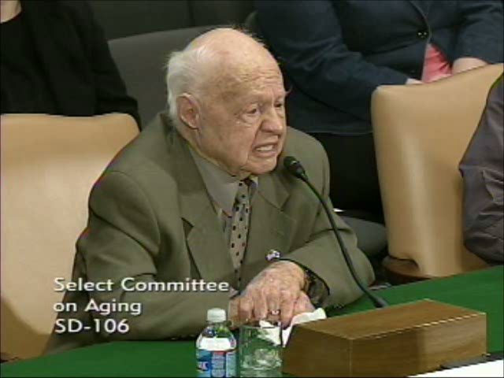
Emotional Abuse
Often accompanied by physical abuse, neglect, and financial exploitation
Creates an environment of “shame” and helplessness that plays a role in the hidden nature of abuse
Can be gradual or sudden
Mickey Rooney Testifies about Elder Abuse
Notes:
[Note to Instructor: The room should be equipped with speakers that will project the audio from the video clip embedded in this slide. If speakers are not available, you may need to hold a microphone to your laptop speaker.
Emotional abuse is often accompanied by other forms of abuse. It creates and environment of shame and helplessness. Emotional abuse can be an ongoing behavior or can seem to appear out of nowhere.
Case Information
The case of actor Mickey Rooney is an example of emotional abuse and domestic violence in later life. On March 2, 2011, Mr. Rooney testified on elder abuse at the request of the U.S. Senate Special Committee on Aging. In February, Mr. Rooney had received a restraining order against his stepson, Christopher Abner. According to court papers, Rooney had to hide in his room to avoid his stepson. Abner deprived Rooney of his medications and food, and he had confiscated Mr. Rooney’s passport and other identification cards.
In this video segment from the hearing, Mr. Rooney discusses the intimidation and harassment he had endured for years. His testimony underscores the power and control that can be wielded by family members and the emotional aspects of abuse that keep victims silent for so long.
[Mouse over to Rooney Photo and clip to play video clip.]
[Note to Instructor: This is a 4-minute video clip. You may need to physically move the cursor on your laptop and click on the Rooney photo to play this video. Be ready with a back-up of the Rooney video clip (located on the CEC website) in case the video does not play from the slide.]

Slide 19
“Red Flags”
Neglect
Lack of basic hygiene
Lack of medical aids (e.g., glasses, walker, hearing aid, medication)
Malnutrition or dehydration
Pressure ulcers
(“bedsores”)
Incapacitated person left without care
Incapacitated person without care
Notes:
[Animated Slide]
Some of the more obvious physical signs of neglect include:
Leaving an incapacitated person without adequate medical care
Pressure ulcers (or “bedsores”), and
Malnutrition or dehydration.
The lack of basic hygiene and lack of medical aids are suggestive of neglect, but may reflect other issues as well. In these cases, self-neglect, financial limitations, or capacity issues may come into play.
[CLICK]
The next example is a criminal neglect case that resulted in the death of an 88-year old incapacitated woman.

Slide 20
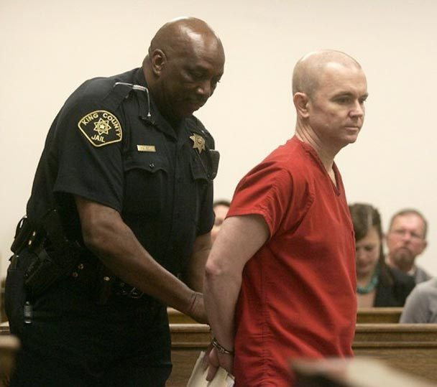
Elder Neglect
The Case of Christopher Wise
Neglect versus honoring victim’s wishes
  Victim’s cognitive impairment and history of seeking medical care must be considered
  Defendant may have ulterior motives (e.g., relying on victim’s social security checks)
Ability to provide adequate care may be an issue
Joey Anchondo / The Seattle Times
Notes:
[Note to Instructor: See the interview with prosecutor Page Ulrey in the instructor’s manual.]
A common defense in elder neglect cases is that the defendant was simply following the victim’s wishes—wishes to avoid medical treatment and to die in one’s own home. In other cases, the ability to provide adequate care is an issue. The caregiver may consider his or her efforts noble and adequate, but they do not meet minimal standards of care. Neglect cases tend to be very challenging to successfully prosecute.
Case Information
The case of Christopher Wise is one in which he claimed to be simply following his mother’s orders. This is a case that occurred in Seattle, Washington and was tried by the King County Prosecuting Attorney’s Office. In 2010, Christopher Wise was convicted of second-degree manslaughter in the death of his 88-year-old mother and sentenced to 27 months in prison plus an additional 12 months for the aggravating factor that the victim was a dependent person for whose care the defendant was responsible.
Evidence of neglect revealed in the course of investigating and prosecuting the case included:
The extreme signs of extended neglect of the mother
When King County sheriff’s deputies found Ruby Wise’s body, she had withered to 70 pounds and was covered in bedsores.
The mother’s dementia and her inability to make competent decisions.
Mr. Wise’s reliance on her social security and disability checks while going to bars and remaining unemployed.
Throughout the trial, Christopher Wise maintained that he was only following his mother’s wishes to die at home.

Slide 21
“Red Flags”
Financial Exploitation
Sudden change in finances and accounts (including unusual withdrawals)
Altered wills and trusts
Improper use/forgery of power of attorney
Loss of property
Checks written as “loans” or “gifts”
Altered wills and trusts
Notes:
[Animated Slide]
Signs of financial exploitation can take many forms. Some of the common “red flags” that should be investigated include sudden changes in finances and accounts (including unusual withdrawals), altered wills and trusts, checks that are written as “loans” or “gifts,” loss of property (including recordings of property deeds that appear to be suspicious), and the improper use or forgery of power of attorney.
CLICK
An example of one of these “red flags”—altered wills and trusts—leading to successful criminal convictions follows on the next slide.

Slide 22
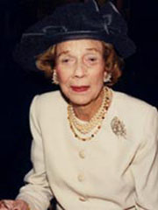
Financial Exploitation
The Case of Philanthropist Brooke Astor
Financial exploitation alleged to be most common form of abuse
Exploitation occurs within the family (children, grandchildren, and relatives)
Defenses often based on the defendants’ perceptions that they are entitled to funds or acting in victim’s best interest
Notes:
[Note to Instructor: See the interview with prosecutor Elizabeth Loewy in the instructor’s manual.]
Altered wills and trusts can be a sign of financial exploitation and other forms of abuse. Some experts indicate that financial exploitation is the most common form of elder abuse and often occurs within the family. Some of the common defenses heard in cases of financial exploitation include the following:
Consent: “He gave it to me. He insisted I take it.”
Legal authority: “I have power of attorney and am only doing what is best for my dad.”
“We are spending down so that he can qualify for Medicaid.”
Loan: “I planned to pay her back really soon.”
“It’s my inheritance and I’ll use it when I need it.”
Case Information
The case of legendary New York philanthropist Brooke Astor demonstrates how an altered will led to a criminal case. Facts of the case:
The case was based on a forged signature on one of the codicils to her will.
In 2009, a jury returned “guilty” verdicts against the two men entrusted with her financial well-being: son Anthony Marshall and estate attorney Francis X. Morrissey, Jr.
Marshall was found guilty on 14 of 16 counts and Morrissey was convicted on counts of fraud, conspiracy, and forgery.
The Astor case will be described in greater detail as we discuss important legal concepts related to elder abuse.

Slide 23
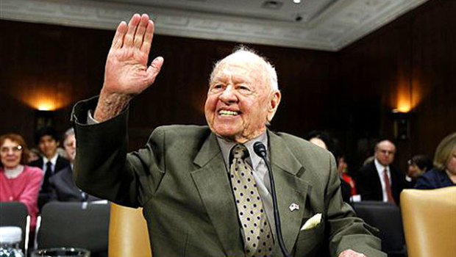
What do these cases have in common?
None of the cases came before the court identified as “elder abuse.”
Notes:
[Animated Slide]
What do these cases have in common?
CLICK
The cases highlighted did not enter the court with specific charges of “elder abuse.”
Mickey Rooney’s experiences came to light in the context of a restraining order.
Christopher Wise was prosecuted on charges of 2nd degree murder or in the alternative 1st degree manslaughter, with an aggravator based on the fact that the victim was unusually vulnerable.
The Brooke Astor case started in Surrogate’s Court, as a challenge to a guardianship. The defendants ultimately were found guilty of fraud, conspiracy, and forgery, not specifically elder abuse.
These case examples underscore the fact that judges will see elder abuse and neglect in a variety of settings and illustrate how cases involving elder abuse may come to the attention of the court.

Slide 24
Key Legal Concepts
Capacity
Consent
Undue Influence
Notes:
[Introductory Slide/Note to Instructor: This slide introduces the next section of the module. The Brooke Astor case is used to elaborate each concept. See the Instructor’s Manual for additional details.]
Background on Brooke Astor Case
Brooke Astor died at the age of 105 in 2007, with an estate estimated to be worth $132 million, in addition to a trust valued at more than $60 million. One of the transactions that became central to both criminal and civil proceedings was a change in her will in 2004, which diverted millions to her son that had been promised to charities. Mrs. Astor was 103 at the time and suffering from Alzheimer’s disease.
Mrs. Astor’s condition came to light a year earlier when one of her grandsons sought to have his father removed as her guardian amidst allegations of neglect and financial exploitation. In the course of the proceedings, Mrs. Astor’s court-appointed attorney observed that a signature on one of the amendments to the will (codicils) purported to be Mrs. Astor’s looked suspicious in comparison to the other documents. After a handwriting analyst confirmed the signature to be a forgery, a criminal investigation was initiated.
The trial that eventually led to the convictions of Mrs. Astor’s son, Anthony Marshall (age 85), and estate attorney Francis Morrissey, Jr. on counts of fraud, conspiracy, and forgery, included 19 weeks of testimony and closing arguments. At the heart of the case were a series of transactions whose legitimacy hinged on evidence of Mrs. Astor’s capacity, her consent to specific actions, and undue influence exerted by the defendants.

Slide 25
Capacity
Capacity is the cluster of mental skills that people use in everyday life. It fluctuates over time, situations & tasks.
memory
logic
behavioral functioning
physical functioning
Capacity
Notes:
[Animated Slide]
Capacity fluctuates over time, situations, and tasks. For example, some people may function better in the morning or early afternoon. People with dementia may experience "sundowning," which is a state of confusion that sets in at the end of the day. Capacity may be greater when the person is in a familiar setting or with people he or she knows well. A person may be able to perform routine tasks (eating, dressing) but have difficulty with tasks that require more steps and attention (preparing meals, managing medications). Also, medications can reduce capacity or mimic incapacity.
CLICK
Capacity is comprised of four basic elements: Memory, Logic, Behavioral Functioning, and Physical Functioning
Astor Case Study
In the case of Mrs. Astor, prosecutors presented evidence to demonstrate her diminishing capacity over time. A key piece of evidence was a letter written by her son, Anthony Marshall, to one of her doctors in 2000 in which he described his mother’s fragile mental state. He wrote that his mother had difficulty getting dressed, writing and spelling, had problems with simple arithmetic, was incoherent and indecisive, and “mixes up words, saying one, meaning another.”

Slide 26
Legal Aspects of Capacity
Standards of capacity vary for different types of transactions. For example:
Testamentary capacity: at the time of executing a will, the person has the capacity to know the natural objects of his/her her bounty, to know the nature and extent of his/her property, and to integrate this knowledge to make a rational plan for disposing of the property.
Contractual capacity: the person can understand the nature and effect of making a contract and the business being transacted (less complicated transaction requires lower level of understanding)
Notes:
State statutes and case law have established standards of capacity for different types of legal transactions, including testamentary, contractual, conveyance of real or personal property, execution of durable power of attorney, and health care decision making.
Two common examples are testamentary capacity, which refers to an individual’s capacity at the time of executing a will, and contractual capacity, in which the capacity to understand the nature and effect of a contract or business transaction is required.
Astor Case Study
The testamentary capacity of Mrs. Astor was a key element in proving the legitimacy of changes to her will. Defense attorneys argued that, despite a diagnosis of Alzheimer’s disease, Mrs. Astor had periods of lucidity and that she had testamentary capacity when she signed the codicils to the will. Prosecutors produced witnesses that stated otherwise.

Slide 27
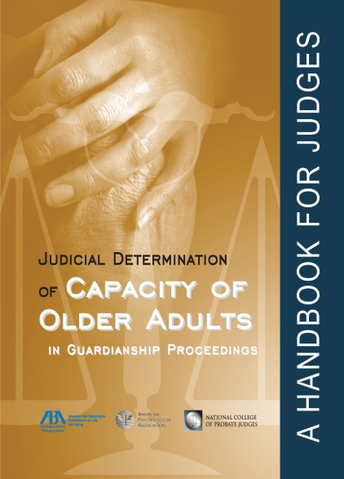
Legal Aspects of Capacity
Determining capacity in older adults can be very difficult and often requires gathering information from many sources. Examples include:
  Family members
  Medical care professionals
    Physician
    Geriatrician
    Neurologist
  Mental health care professionals
    Geriatric Psychiatrist or Psychologist
    Forensic Psychiatrist or Psychologist
  Adult protective services workers
Notes:
Determining capacity in older adults can be difficult.
Generally, capacity determinations should include the collection of information from a variety of sources, including family members, medical care experts, mental health professionals, and adult protective services. It is particularly helpful to include experts who have some expertise in geriatrics.
Astor Case Study
The Astor case included over 70 witnesses for the prosecution, including expert witnesses—trust and estate attorney, geriatric psychiatrist, and handwriting analyst. The trial featured testimony from the treating physician, home nurses and aides, housekeepers, personal staff, and two grandsons. Other witnesses included some of Mrs. Astor’s well-known friends, such as former Secretary of State Henry Kissinger and Barbara Walters.

Slide 28
Consent
Consent requires an individual to be able to:
Understand the transaction or activity
Make judgments about it
Consent is a significant factor in determining the legitimacy of a wide range of actions.
An issue in determining whether a crime has been committed (especially intimate crimes)
An important issue in legal transactions
Decide if it is something he or she chooses to do
A fundamental issue for APS (capacity to consent)
Notes:
Consent requires an individual to be able to:
Understand the transaction,
Make judgments about it, and
Decide if it is something he or she chooses to do.
It can be more difficult to apply the familiar legal concept of consent to actions of older persons who may not have the capacity to consent.
Consent is an important factor in determining whether a crime has been committed—this is particularly challenging in intimate partner crimes, especially crimes that require a true level of consent for sexual relations. The capacity to consent is a fundamental issue in legal transactions and for Adult Protective Services (APS), especially in cases in which they must determine capacity to consent of those who refuse services.
Astor Case Study
Even if the defense had been able to establish Mrs. Astor’s capacity, her consent to each of the transactions remained in dispute. Did Mrs. Astor understand the event, was she able to make a rational judgment about it, and did she freely choose to change her will? Testimony from one of Mrs. Astor’s nurses stated, in substance, that the defendants had physically dragged Mrs. Astor into a room to execute one of the codicils to her will, a document she had not been shown before that day. Minutes later, Mrs. Astor exited and asked what had just happened. This testimony questions Mrs. Astor’s consent to this particular amendment to her will.

Slide 29
Undue Influence
Undue influence is the misuse of one’s role and power to exploit the trust, dependence, and/or fear of another to deceptively gain control over that person’s decision making or assets.
Undue Influence
Power
Relationship
Opportunity
Loss or harm to person
Notes:
Undue influence focuses on the relationship between the vulnerable individual and another person, coupled with that person’s opportunity and power to manipulate the vulnerable person’s thoughts and actions.
Astor Case Study
The case of Mrs. Astor demonstrated all the elements of undue influence.
The defendant had legal power through the POA that allowed him to act on his mother’s behalf and control her physical environment.
He had a trusted relationship as an only child.
He had opportunity to exploit his power and relationship because his mother had advanced Alzheimer’s disease.
His actions resulted in harm to Mrs. Astor by isolating her from friends, depriving her of the living standards her wealth could provide, and diverting her assets away from charities she intended to support.
A prime example of undue influence is the prosecution’s contention that Mr. Marshall tricked his mother into thinking it was necessary to sell a well-known painting by telling her she was running out of money (he sold the painting for $10 million and kept $2 million as his commission).

Slide 30
Undue Influence
Undue influence typically is not a crime; rather it is a means to commit a crime, such as exploitation and other forms of financial abuse.
Undue influence often is alleged in disputes over the validity of wills, conveyances of property, contracts and powers of attorney.
Undue influence is a factor in decisions about the need to protect a person through guardianship and/or conservatorship.
Notes:
Undue influence typically is not a crime, but a means to commit a crime. Undue influence is often referred to in civil and probate codes (especially those pertaining to wills and other conveyances of property/assets and guardianship/conservatorship proceedings) and in Adult Protective Service Statutes.
Astor Case Study
In the Astor criminal case, the term “undue influence” was not used.
However, testimony regarding facts that could constitute undue influence in a civil proceeding was admitted to support the charge that the defendants conspired to steal from Mrs. Astor’s estate.
On the civil side, undue influence was a factor in the grandson’s petition to have his father removed as her guardian.
As the Astor case demonstrates, the legal concepts of capacity, consent, and undue influence are often subtle and can be difficult to prove in specific actions at particular periods of time.

Slide 31
Implications for the Court
The identification of elder abuse can be difficult.
Elder abuse may be an underlying factor in a variety of court cases involving older persons.
Transactions involving older persons may need additional scrutiny.
More cases will involve complex issues of capacity and consent.
Notes:
[Animated Slide]
What are some of the implications for the court?
CLICK Identification of elder abuse can be difficult.
CLICK Elder abuse may be an underlying factor in a variety of court cases involving older persons.
CLICK Transactions involving older persons may need additional scrutiny.
CLICK More cases will involve complex issues of capacity and consent.

Slide 32
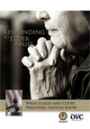
DVD Presentation
Responding to Elder Abuse
What Judges and Court
Personnel Should Know
Notes:
[Note to Instructor: Length of DVD presentation is 13:45 Minutes]
DVD Instructions
The room should be equipped with speakers that will project the audio from the laptop. If speakers are not available, you may need to hold a microphone to your laptop speaker.
Insert DVD in your laptop.
CLICK on Main Menu
CLICK on ➢ Play Video

Slide 33
Additional Resources
Visit the National Center for State Courts’ Center for Elders and the Courts at
www.eldersandcourts.org

