Slide 1

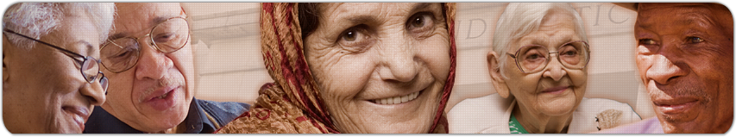
Module One:
www.eldersandcourts.org
Elder Abuse & Neglect
The Physiology of Aging
The National Center for State Courts developed this curriculum in collaboration with the Center of Excellence on Elder Abuse and Neglect at the University of California, Irvine School of Medicine with support from the Retirement Research Foundation of Chicago (grant number 2008-056).
Notes:
Note to Instructor: Some slides are animated and require you to CLICK to advance to the next discussion point. Animated slides are noted as such and include CLICK instructions.
The Notes included in this presentation are an abbreviated version of those found in the Instructor’s Manual. See the manual for more detailed information.
Recommended Presentation Time: 60 minutes

Slide 2
Module One Goal
Goal
Judicial officers will understand the physical, emotional, and cognitive effects of aging and their impact on the vulnerability of older persons.

Slide 3

Module One Objectives
At the conclusion of Module One, judges should be knowledgeable about
    Demographics of aging
    Myths and facts of aging
    Common aspects of aging
    Age-associated vulnerabilities
Notes:
[Animated Slide]
CLICK to introduce each objective.

Slide 4
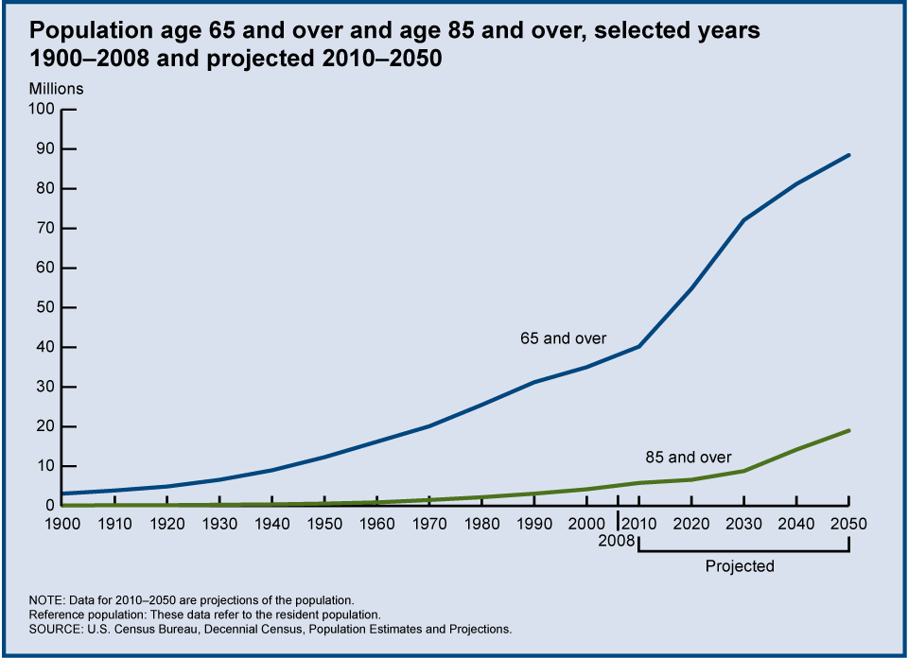
Demographics of Aging
65 & over
2030
72 million
20% population
2008
39 million
13% population
85 & over
2050
2008
5.7 million
19 million
Notes:
[Animated Graphic]
The U.S. population is undergoing a demographic transition.
[CLICK]: In 2008, 39 million people age 65 & over comprised approximately 13% of the population.
[CLICK]: Projected figures for 2030 estimate that 72 million people age 65 & over will comprise 20% of the population. That’s almost a doubling of the elderly population.
[CLICK]: We can also look at the older population, those over the age of 85. In 2008, there were 5.7 million people aged 85 & over. This number is projected to more than triple in 2050 when there will be approximately 19 million people aged 85 & over.

Slide 5
State-Specific Demographics
Add a slide referring to your state’s aging population
Notes:
[Note to Instructor: Please see the appendix to the instructor’s manual for instructions on where to find demographic information about your state’s aging population.]

Slide 6
Demographics of Aging
There will be more older Americans than at any other time in history, living longer lives.
All sectors of society will be increasingly strained to meet the needs of older Americans.
Notes:
Baby boomers are those born between 1946 and 1964 (post-WWII).
The oldest of the “boomers” started turning 65, the traditional retirement age, in 2011.
This population increase must be viewed in the context of another fact—Americans are living longer than ever.
The life expectancy for a baby born in 2009 now exceeds 78 years (78 years and 2 months). That’s two years longer than the expected life span 20 years ago and nearly 9 years longer than life expectancy in 1900.
The combination of a large population of older Americans living longer lives is expected to strain all sectors of society, including the justice system.

Slide 7
Gender and Aging
Women’s longer life expectancies mean that a disproportionate number of elders are women.
Elderly women are more likely than men to be widowed or divorced and living alone.
Women’s incomes are significantly lower than men’s for every age group over 50.
Vulnerability
- Living Longer
- Single
- Living Alone
- Poverty
Notes:
Generally, vulnerability tends to increase for those who are very old, single, living alone, and impoverished. These conditions tend to be more common for older women than for older men.
Women live longer.
The life expectancy for women (80.5) is 5 years greater than for men (75.5). Of those 85 and over, two-thirds are women.
Older women are more likely to be single.
Older men are more likely to be married and living with a spouse than are older women. Women age 65 and over were three times as likely as men of the same age to be widowed (42 percent compared with 14 percent).
Older women are more likely to live alone.
Forty percent of women over the age of 65 live alone, compared to 19 percent of men over age 65.
Older women are more likely to live in poverty.
Past the age of 50, women’s incomes are significantly lower than men’s incomes. Median family income for women age 85 and older amounts to only 65 percent of median family income for men over 85.

Slide 8
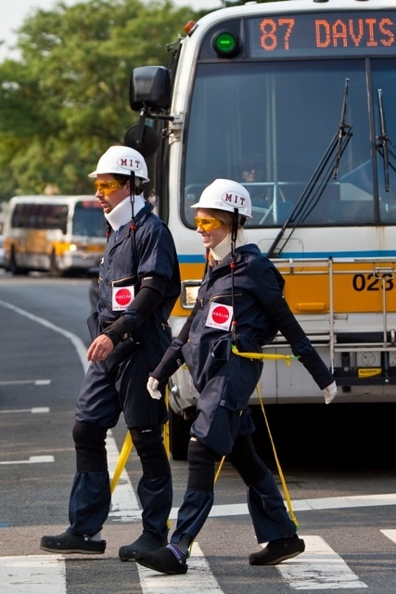
Interactive Exercise
Meet AGNES
Age
Gain
Now
Empathy
System
Photo by Nathan Fried Lipski. Used with permission from MIT AgeLab.
Notes:
[Interactive Exercise]
Ask participants: WHAT’S IT LIKE TO BE REALLY OLD—OVER THE AGE OF 80?
Ask them to call out things they associate with old age. As they call out their responses, write them on a board. After 7 or 8 responses, begin to summarize them into main themes.
Common examples might include normal physical changes (wrinkles, gray hair), common but not normal physical changes (osteoporosis, hearing loss), cognitive changes (memory lapses), and attitudes and behaviors (clothing styles, political attitudes).
Ask how these views might affect how they conduct their work. One could also ask how these perceptions might impact the deliberations of jurors, or assumptions made by prosecutors or defense attorneys.
About the Photo: The photo is an “aging” suit developed by MIT’s AgeLab that is used by developers, researchers, and marketers to empathize with older adults. It simulates what it may feel like to be a person in her mid-70s. The suit has harnesses and bands that restrict joint and limb movements and has a helmet attached to a harness that constrains the neck and spine, plastic gloves that make it harder to open packages, and foam soles on the shoes to throw off balance.

Slide 9
Myths and Facts of Aging
Myth: Due to failing memories and confusion, older people make poor witnesses
Fact: Age alone does not affect a person’s credibility
ISSUE: Will judges and jurors accept an older person’s testimony as truthful and accurate?
Notes:
[Animated Slide]
People age very differently. Yet there are a number of assumptions that people make about older persons that can influence decisions in the courtroom.
Myth: Because older people are commonly perceived as forgetful and confused, they are also often perceived as poor witnesses. Consequently, there may be a reluctance on the part of jurors and judges to accept that an older person’s testimony is truthful and accurate.
Fact: Age alone does not affect one’s credibility. An older person can be an excellent witness and retain the ability to recall facts. There may be a difference, however, in how the older person presents those facts and in their level of anxiety if asked to testify—tendencies that can be overcome with good interviewing skills, patience, and witness preparation. In addition, prosecutors are finding that even those with dementia have an ability to remember traumatic events clearly, even though they may be unable to recall other parts of their history or their lives.
[CLICK] Issue:
If judges and jurors perceive that memory naturally fades with age, they may be less likely to perceive an older person’s testimony as truthful and accurate. This is particularly critical when the witnesses are very old.

Slide 10
Myths and Facts of Aging
Myth: As people age, they will eventually be fully incapacitated
Fact: Incapacity is not part of the normal aging process and fluctuates when it does occur
ISSUES: How does age influence judicial determination of incapacity? How can the court accommodate fluctuating levels of capacity?
Notes:
[Animated Slide]
Myth: The normal aging process necessarily results in incapacity. When incapacity does occur, it tends to impact every aspect of one’s life.
Fact: Capacity is a very complex concept. Capacity can fluctuate over time and from one circumstance to another. It is not an all-or-nothing condition. An individual may demonstrate incapacity in one aspect of life (such as managing money) but be totally competent in all others.
[CLICK] Issues:
(1) Age itself should not be used as a determinant of capacity. Judges should depend on reliable capacity assessments carried out by professionals, and even then, must consider the motives behind a hearing to determine capacity (particularly relevant to guardianships and conservatorships).
(2) Elderly litigants and witnesses may be better functioning during certain times of the day. The court should consider making calendaring accommodations that will enhance an older person’s ability to fully participate in the court case. In addition, judges may need to consider how certain medications may mimic behaviors that are suggestive of incapacity.
These facts can be integrated into a judicial approach that assumes that all adults, regardless of age, are fully competent and capable individuals who have the power to make their own decisions and to be held accountable for their actions.

Slide 11
Vulnerability
What makes elders more vulnerable?
Physical Impairments
Emotional Issues
Cognitive Impairments
Notes:
[Introductory Slide]
[Note to Instructor: This slide introduces the next section of the module, which focuses on vulnerability caused by physical impairments, emotional issues, and cognitive impairments.]
In this next section, we will talk about factors that make elders more vulnerable. You will meet three fictional characters:
Marva, who has some physical impairments
Ed, who is trying to address some emotional problems, and
Clara, who is suffering from cognitive impairments.

Slide 12

The Case of “Marva”
Notes:
[Note to Instructor: A full summary of this scenario can be found in the instructor’s manual. Provide the background information on Marva, and then refer to her to highlight the information in this section of the presentation.]
Marva’s Background
Let’s meet a stranger from the photographs—we’ll call her “Marva.” As we walk you through Marva’s fictional life, consider how vulnerable she becomes as she ages and experiences changes in her physical health.
Marva is in her early 70s and has been in relatively good physical health, although she suffers from arthritis and high blood pressure. Marva recently began taking prescribed medication to treat high blood pressure and she also takes Tylenol to ease the muscle aches from her exercise routine. She works hard to maintain her health and is a regular at the senior zumba classes at the local fitness center. Marva lives alone and has always maintained her independence.

Slide 13
Common Aspects of Aging
Sensory changes—hearing loss, vision disorders
Cardiovascular changes—higher blood pressure
Musculoskeletal changes—bone density, arthritis
Neurological changes—decreased reaction time
Notes:
Marva
You can see that Marva’s initial health concerns—arthritis and high blood pressure—are pretty typical.
Other common aspects of aging include poorer eyesight and hearing, a loss of bone density and osteoporosis, and decreased reaction time. While everyone ages differently, it is relatively common for most people to experience these types of physical changes.

Slide 14
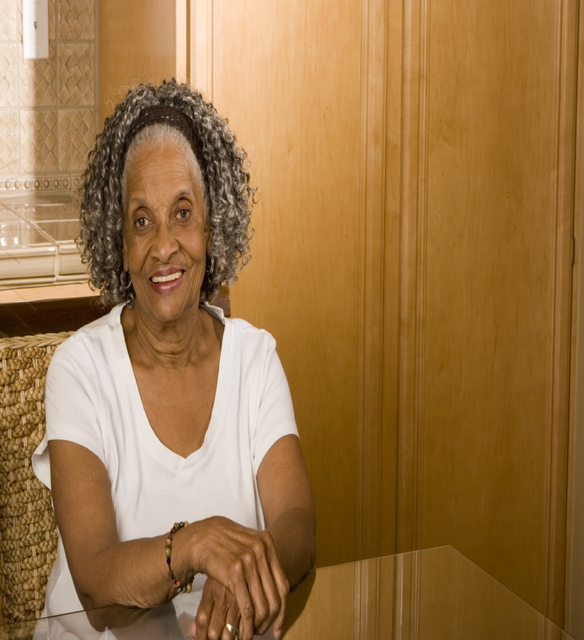
Physical Vulnerabilities
Normal changes, such as thinner skin and slower reaction times
Greater susceptibility to disease and illness
Medications are generally not metabolized as rapidly
Notes:
Marva
Marva’s age means that she can expect to have thinner skin and slower reaction times, is more susceptible to disease and illness, and that the medications she uses are not metabolized as rapidly.
For example, Marva notices that she bruises a lot easier than in her younger years. And it takes her a little longer to get in and out of the car. She also feels her prescription medications and her standard glass of wine have a greater impact on her now that she is in her 70s.
Some of the normal age-related changes not only make people more vulnerable, they also can mask or mimic signs of elder abuse. For example, the presence of bruising is likely to be more common, and slower reaction times will make older persons more vulnerable for the simple reason that they can’t easily protect themselves from physical attacks.
Older persons are more susceptible to disease and illness, simply as a function of age. There are some progressive diseases, such as Parkinson’s Disease, that increase with age and make people more dependent over time. Poor health and dependence on another for basic care giving will increase one’s vulnerability.
Medications are also processed differently by older persons. It can be difficult to sort out the effects of age versus the effects of medication. [see next slide]

Slide 15
Effects of Common Medications
Treatments for high blood pressure, allergies, and anxiety
Side effects may include confusion, drowsiness, dizziness, and falls
Notes:
Marva
Recently, Marva has begun to experience short bouts of dizziness and confusion. She and her friends assume that her increased levels of confusion and dizziness are simply a “normal” part of aging.
If Marva is fortunate enough to visit a gerontologist, she might learn that her mental state could be a result of the way her body responds to common medications, even the use of something as simple as “Tylenol.” She may also learn that she is combining the wrong types of medicines or over-medicating.
Examples of common side effects of medicines:
High blood pressure medications can cause the blood pressure to drop quickly when moving from lying to sitting or sitting to standing, resulting in dizziness.
Anxiety medications can cause drowsiness, confusion, and falls
Even common over-the-counter medications, such as “Tylenol PM” and “Benadryl” can cause confusion and lead to falls.

Slide 16
IADLs and ADLs
Instrumental Activities of Daily Living
Activities needed for independence in the community
Handling finances
Use of telephone
Transportation
Medication management
Meal preparation
Shopping
Activities of Daily Living
Activities needed for independence in the home
Mobility
Bathing
Dressing
Feeding oneself
Toileting
Continence
Notes:
[Animated Slide]
Marva
Marva’s health takes a sudden downturn after she takes a nasty fall outside the fitness center and ends up with a broken hip. Her broken hip drastically impacts her independence and ability to maintain her active lifestyle. Due to her age and the fact that she lives alone, the attending physician assesses Marva’s ability to live independently in the community and in her home. Her medical history will soon be taken over by the concepts of IADL (Instrumental Activities of Daily Living) and ADL (Activities of Daily Living).
CLICK
IADLs include activities that are needed for independence in the community, such as using a telephone and preparing meals. An individual with basic IADLs can typically manage to maintain a fair amount of independence, but some assistance is likely to be needed.
CLICK
ADLs are those activities that are needed to remain independent in one’s home. They include such things as mobility and the ability to feed oneself.

Slide 17
Functional Limitations
14% experience IADL limitations
e.g., shopping, managing money
25% experience IADL and at least one ADL limitation
e.g., bathing, dressing, using the toilet
39% of elders have some type of functional limitation
Reference population: These data refer to Medicare enrollees age 65 and over.
Source: Centers for Medicare and Medicaid Services, Medicare Current Beneficiary Survey.
Notes:
Marva
Marva’s broken hip will keep her in a wheelchair for a significant period of time. Reluctantly, she asks her niece for assistance while she rehabilitates. Marva will need help with three IADLs (transportation, shopping and meal preparation) and completing everyday tasks such as dressing and bathing (ADLs). This makes her typical of 25% of all persons over the age of 65. As Marva’s experience demonstrates, both types of functional limitations can be the result of an unexpected event and be temporary in nature.
Although this data indicates that 39% of Medicare enrollees over the age of 65 have some type of functional limitation, it is just as important to note that 61% do not. Those who do have some type of functional limitation, such as Marva, will be more vulnerable to abuse and neglect because they are unable to defend themselves from physical harm, are more likely to have diminished physical and/or mental abilities, and must depend on others for basic needs.

Slide 18
Health Issues for People Age 85+
Prevalence of Chronic Conditions, Disability, and Functional Limitations
AARP “Beyond 50: A Report to the Nation on Trends in Health Security.”
(Washington, D.C.: AARP, May 2002). Data is from 1996.
Notes:
Marva
While Marva may eventually bounce back from her fall, she realizes that her health may not look very promising in another 10 years, when she is in her mid-80s. Statistics show that almost all persons over the age of 85 (96%) have either a chronic condition, a disability, or some type of functional limitation. In fact, 44% of people 85 and plus experience all three problems. Only 4% of Medicare enrollees aged 85 & over reported no issues with functional limitations.
[Instructor Note on Definitions]
Chronic diseases are long-term illnesses that are rarely cured, such as heart disease, stroke, cancer, and diabetes. Chronic health conditions negatively affect quality of life, contributing to declines in functioning and the inability to remain in the community.
“Disability”: a physical or mental impairment that substantially limits one or more of the major life activities of such individual; a record of such an impairment; or being regarded as having such an impairment.
Functional Limitations are limitations in one’s ability to carry out activities of daily living (ADLs) or instrumental activities of daily living (IADLs).

Slide 19
Interactive Exercise
How might Marva’s physical condition make her more vulnerable to abuse, neglect, or financial exploitation?
What issues might bring Marva to the attention of the court?
Marva’s Physical Impairments
Notes:
[Interactive Exercise/Animated Slide]
Ask participants:
CLICK Now that you have been introduced to Marva, in what ways is she more vulnerable to physical abuse, neglect, or financial exploitation? Can you create some scenarios in which you could see abuse happening?
Anticipated responses:
She is dependent on her niece, whom she was “reluctant” to call; the niece could be verbally or physically abusive; her physical dependence also makes her more vulnerable to neglect.
Marva is having some cognitive issues as a result of medication; she may be more easily manipulated
She may be more susceptible to financial exploitation because she will be dependent on others for help in maintaining her current home while she recuperates, and she will need help accessing cash and taking care of business transactions.
CLICK What issues might bring Marva to the attention of the court?

Slide 20
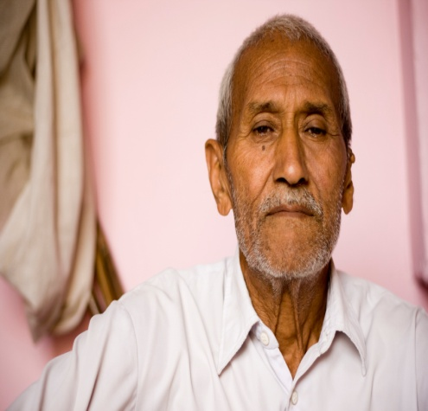
Emotional Vulnerabilities
Issues:
Depression & anxiety
Coping with multiple losses
Fear of losing independence
can make older people more vulnerable to threats
Notes:
[Note to Instructor: A full summary of this scenario can be found in the instructor’s manual. Provide the background information on Ed, and then refer to him to highlight the information in the next two slides.]
Ed’s Background
We’ll now turn our attention to emotional vulnerabilities by meeting “Ed.” Ed worked in the banking industry most of his adult life and has enjoyed a pleasant retirement. His wife recently died, and his adult children live in other parts of the country. He is a proud man and is insistent on maintaining his home without any outside help. Lately, his neighbors have begun to complain about his unkempt yard and he has become more reclusive.
Ed may be suffering from depression and he is coping with a major loss. While the source of his depression is likely a result of the loss of his partner, older persons often experience many losses that leave them emotionally vulnerable. In addition to the loss of a spouse or partner, older people may experience the loss of friends, status, the ability to earn an income, a driver’s license, and independence.
Ed’s biggest fear now is the fear of losing his ability to live independently in his own home. This makes him particularly vulnerable to suggestions that he can no longer maintain his home.

Slide 21
Emotional Vulnerabilities
Why do depression & anxiety often go undiagnosed and untreated in older adults?
Physicians
Don’t ask/listen
Normalize depression
Older Adults
Subject is taboo
Depression is a part of aging
Afraid to “become a burden”
Notes:
Depression is not a normal part of aging and can be treated. But Ed’s depression is not taken seriously and is left untreated.
Ed’s reluctance to discuss depression
Ed is reluctant to discuss his emotional state with his doctor—depression is an off-limits subject to men of his generation. Besides, with all that he has suffered, he feels that depression is simply part of the grieving process. Ultimately, he is afraid that any sign of weakness, including depression, will be used to force him into a “retirement home.”
Doctor’s reluctance to discuss depression
When he does meet with his family physician, his doctor doesn’t specifically ask about depressive symptoms, and when Ed mentions his recent loss, the doctor remarks that depression is a normal reaction for someone of his circumstance and age. The doctor further suggests that Ed make a concerted effort to participate in senior outings and join groups that may be of interest to him. Neither Ed nor the doctor have any further discussions of the subject.
Ed’s depression make him increasingly vulnerable.
Ed takes the doctor’s advice to participate in activities. A continuing interest in finance and the decline of his retirement portfolio from the recession leads him to notice an advertisement in the local paper aimed at those age 60 and above. He signs up for a seminar called “Come Learn from the IRA Technician,” that will provide tips on “how to guarantee your IRA will never run out, regardless of market fluctuations.” Even better, the seminar is free and includes a top sirloin steak for lunch. Not only does Ed enjoy the seminar, he becomes enamored with one of the presenters, a divorced middle-aged woman with an eye for numbers.

Slide 22
Interactive Exercise
How might Ed’s emotional state make him more vulnerable to abuse, neglect, or financial exploitation?
What issues might bring Ed to the attention of the court?
Ed’s Emotional Issues
Notes:
[Interactive Exercise/Animated Slide]
Ask participants:
CLICK Now that you have met Ed and learned of his emotional state, in what ways is he more vulnerable to physical abuse, neglect, or financial exploitation? Can you create some scenarios in which abuse or neglect might occur?
Anticipated responses:
His depression could lead to self-neglect, including the neglect of his home.
He is despondent and is lonely, which makes him vulnerable to financial exploitation by those who can take advantage of his need for companionship. His strong desire to maintain his house also makes him vulnerable to stranger exploitation, such as driveway paver scams.
He may be more vulnerable to getting involved in a relationship with someone with less that altruistic intentions.
CLICK What issues might bring Ed to the attention of the court?

Slide 23
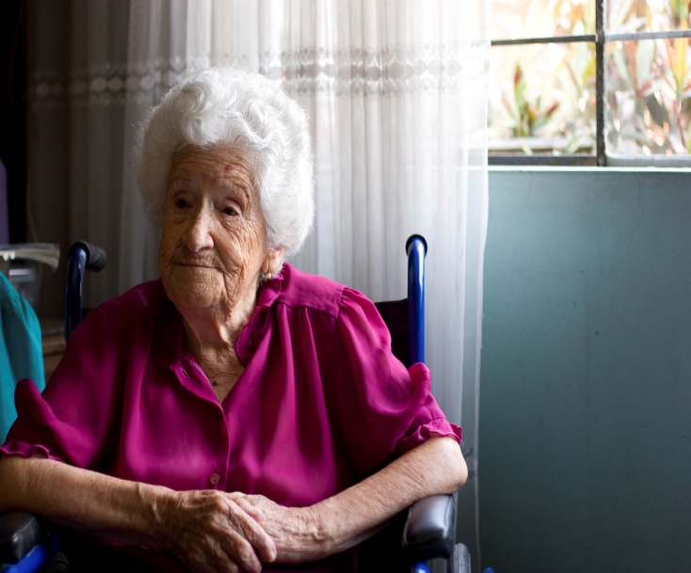
Cognitive Vulnerabilities
Cognitive changes may be subtle or obvious
Cognition may vary by time of day
Cognition may vary by circumstance
Notes:
[Note to Instructor: A full summary of this scenario can be found in the instructor’s manual. Provide the background information on Clara, and then refer to her to highlight the information in this section of the presentation.]
Clara’s Background
We now introduce you to “Clara,” who has some cognitive problems. As we will explore in the next set of slides
“Cognition” encompasses a variety of abilities including memory, language (verbal and written), spatial skills, judgment, and reasoning.
It is not always easy to recognize changes in cognition, partly because cognition can vary by the time of day and by circumstance.
This is true in Clara’s case, at least at the beginning of her problems. Clara, who is in her late 80s, has limited mobility and occasionally uses a wheelchair. Up to this year, she has maintained her sharp memory and intellect and often talks about her experiences as a former school teacher. She lives with her son’s family.
Lately, her memory has been failing and she has experienced some difficulties recalling basic vocabulary. Some days Clara seems her old self, while other days she appears to have more cognitive problems.

Slide 24
Characteristics of Dementia
Dementia must include decline in memory and at least one of the following cognitive abilities
Ability to recognize or identify objects
Ability to execute motor activities
Ability to generate coherent speech or understand spoken or written language
Ability to think abstractly, make sound judgments and plan and carry out complex tasks
The decline in cognitive abilities must be severe enough to interfere with daily life
Notes:
[Animated Slide]
Clara’s children worry that she may be slipping toward dementia, though they are uncertain how dementia is documented and exactly what it entails. They speak to her physician about their concerns.
The doctor explains that dementia is a descriptive term for a collection of symptoms that affect the brain. A diagnosis of dementia must include a decline in memory and the loss of at least one of the following cognitive abilities:
Ability to generate coherent speech or understand spoken or written language
Ability to recognize or identify objects
Ability to execute motor activities (such as driving, using a computer mouse, pouring a glass of juice)
Ability to think abstractly, make sound judgments, and plan and carry out complex tasks.
CLICK Clara is not diagnosed with dementia at this time. The doctor explains that the other critical aspect of dementia is that the loss in cognitive abilities must be severe enough to interfere with daily life. In the initial stages of her disease, Clara’s dementia is not diagnosed because her cognitive impairments do not interfere with her daily life.

Slide 25
Alzheimer’s Disease
Alzheimer’s Disease
Most common type of dementia that accounts for 60-80 percent of cases
The greatest risk factor is advancing age; 43% of people over 85 have Alzheimer’s Disease
More women than men have Alzheimer’s Disease
The number of people 65+ with Alzheimer’s disease is estimated to reach 7.7 million in 2030
Notes:
As Clara’s cognitive abilities decline further, the doctor eventually makes the diagnosis of Alzheimer’s Disease. The doctor explains that Alzheimer’s Disease affects different people in different ways, but:
The disruption of brain cell function usually begins in regions involved in forming new memories. Consequently, the most common symptom is greater difficulty in remembering new information
As damage spreads, people experience other difficulties: confusion with time or place, decreased or poor judgment, and withdrawal from work or social activities
Clara’s doctor provides the family with several pamphlets and a list of local resources. They learn that:
The most common type of dementia is Alzheimer’s disease, accounting for 60 to 80 percent of cases.
Alzheimer’s is not a normal part of aging, but the greatest risk factor is advancing age. Four in ten people (43%) over the age of 85 have been diagnosed with the disease.
Alzheimer’s Disease is more common among women than men.
The number of people with Alzheimer’s is expected to rise, from 5.2 million elders to 7.7 million by the year 2030. It is the 6th leading cause of death in America.

Slide 26
Early Alzheimer’s Disease
Vulnerability to financial abuse
Short term memory
Words
Judgment
SYMPTOMS
Common Issues
Should the individual continue to drive?
Can the person continue to manage his or her finances?
Notes:
[Animated Slide]
Clara’s appearance remains good, but the doctor notes that she is beginning to have significant impairments in her short-term memory, language, judgment and reasoning.
For example, Clara can remember the name of her third grade teacher, but can’t remember what she ate for breakfast. She sometimes can’t pull out simple vocabulary words (she may refer to a watch as “the thing that tells time.”) Clara has difficulty understanding complicated information and making decisions
CLICK Common Issues:
The doctor mentions that several issues often come up for families at this point, including:
Whether the individual should continue to drive, though Clara gave up driving long ago, and
Whether the person can continue to manage his or her finances.
Clara is especially susceptible to financial abuse at this stage. She still handles many of her finances, but due to her impaired judgment, she could be convinced to give her checkbook or her credit card information to someone she would not have trusted before these symptoms began.

Slide 27
Moderate Alzheimer’s Disease
Vulnerability to Physical abuse
Behavior
Dressing
Insight
SYMPTOMS
Common Issues
Is the person safe at home?
Can the person continue to function independently?
Notes:
[Animated Slide]
Clara’s health continues to deteriorate. She has been found wandering in the neighborhood and she is beginning to have problems with behavior, dressing, and insight.
She sometimes becomes belligerent, exhibits irrational fears (e.g., of water), and becomes violent (e.g., hitting).
She has trouble selecting appropriate clothes when getting dressed.
Her insight is also impaired. There are many days when she thinks she doesn’t have a problem and no amount of explanation seems to help.
CLICK Common Issues:
Key question that the family struggles with is whether Clara can remain at home and to what extent she can live independently.
Clara is more vulnerable to physical abuse at this stage of her disease. Data show that people with dementia who are verbally or physically aggressive, as Clara can be, are more likely to be physically abused by a caregiver.

Slide 28
Severe Alzheimer’s Disease
Vulnerability to Neglect
Communication
Mobility
Swallowing
SYMPTOMS
Common Issues
What are the risks and benefits of medical intervention?
What measures should be taken to ensure proper nutrition?
Notes:
[Animated Slide]
As Clara’s disease has progressed, the family has reluctantly placed her in an assisted living facility, where she resides in a special wing for Alzheimer’s patients. Clara now is suffering from severe symptoms of Alzheimer’s disease, including problems with communication, mobility, and swallowing.
The doctor notes that her motor cortex is affected, which makes it more difficult for Clara to walk and swallow.
There are days when she is non-verbal and other days when she is incoherent (speaks in “word salad”).
She needs increasing levels of care.
CLICK Common Issues:
Clara’s family is now struggling with end-of-life issues for Clara. They have to consider when and if she should be placed in a hospice. If she should fall and break a hip, what should be the appropriate course of action? If Clara stops eating, should a feeding tube be used? The types of decisions to consider may revolve around end-of-life issues and how to maintain comfort.
In this late stage of Alzheimer’s disease, when Clara is more likely to need assistance with activities such as bathing, hygiene, eating, she becomes more vulnerable to neglect.

Slide 29
Interactive Exercise
What issues might bring Clara to the attention of the court?
Clara’s Cognitive Impairments
Notes:
Animated Slide]
CLICK Ask participants:
We’ve discussed how Clara’s physical, psychological, and cognitive impairments increase her vulnerability to financial exploitation, physical abuse, and neglect. What issues might bring Clara to the attention of the court?

Slide 30
Implications for the Court
More elders will come before the court
More cases will involve medical & psychological terminology
Accommodations for elders will be imperative
More cases will require assessments by medical professionals
Notes:
[Animated Slide]
The increase in the number of older persons, greater longevity, and the complexity of physiological and cognitive functioning carries a number of implications for the courts. We can expect the following scenario:
CLICK More elders will come before the court
CLICK More cases will involve medical & psychological terminology
CLICK Accommodations for elders will be imperative
CLICK More cases will require assessments by medical professionals
If Time, Ask participants: Given all that we’ve just discussed, what other implications might there be for the court?

Slide 31
“…Elder abuse and financial exploitation will appear in increasing numbers on the civil and criminal dockets. …Every court needs to take a close look at their preparedness, because the numbers are coming whether they’re prepared or not.” —Sally Hurme, AARP
Notes:
This concludes Module One.

Slide 32
Additional Resources
Visit the National Center for State Courts’ Center for Elders and the Courts at
www.eldersandcourts.org

